Slide 1
Attaché Baltique
Business Concierge Services
in the Baltic States
Presented by Jelena Osipkova Riga, 2016

Slide 2

Founder & Managing Director

Slide 3
Business concierge service
Communication
Translation in Latvian, Russian, English and French languages
Written and verbal communication
Translation during business negotiations
Business correspondence
Legal Affairs
Business services
Financial and fiscal services
Legal advice and services
Notary Services
Real Estate
Real estate property: purchase, sale, rental
Legal administrative services
Documents preparation
Property management

Slide 4


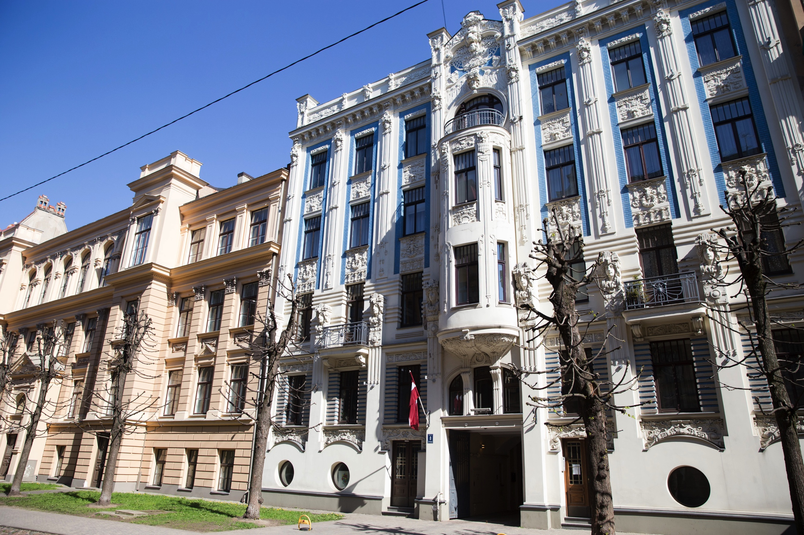

Business concierge service
http://concierge.attachebaltique.com/eng

Slide 5

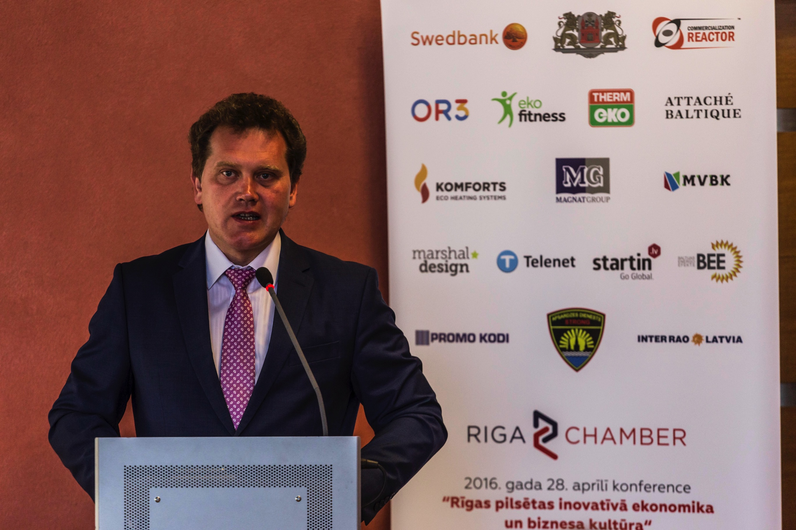
Event Management
Event Management
Business conferences
Parties: corporate, christmas, summer
Product launches
Event theming and décor
Team building activities
Press event
Dinners

Slide 6
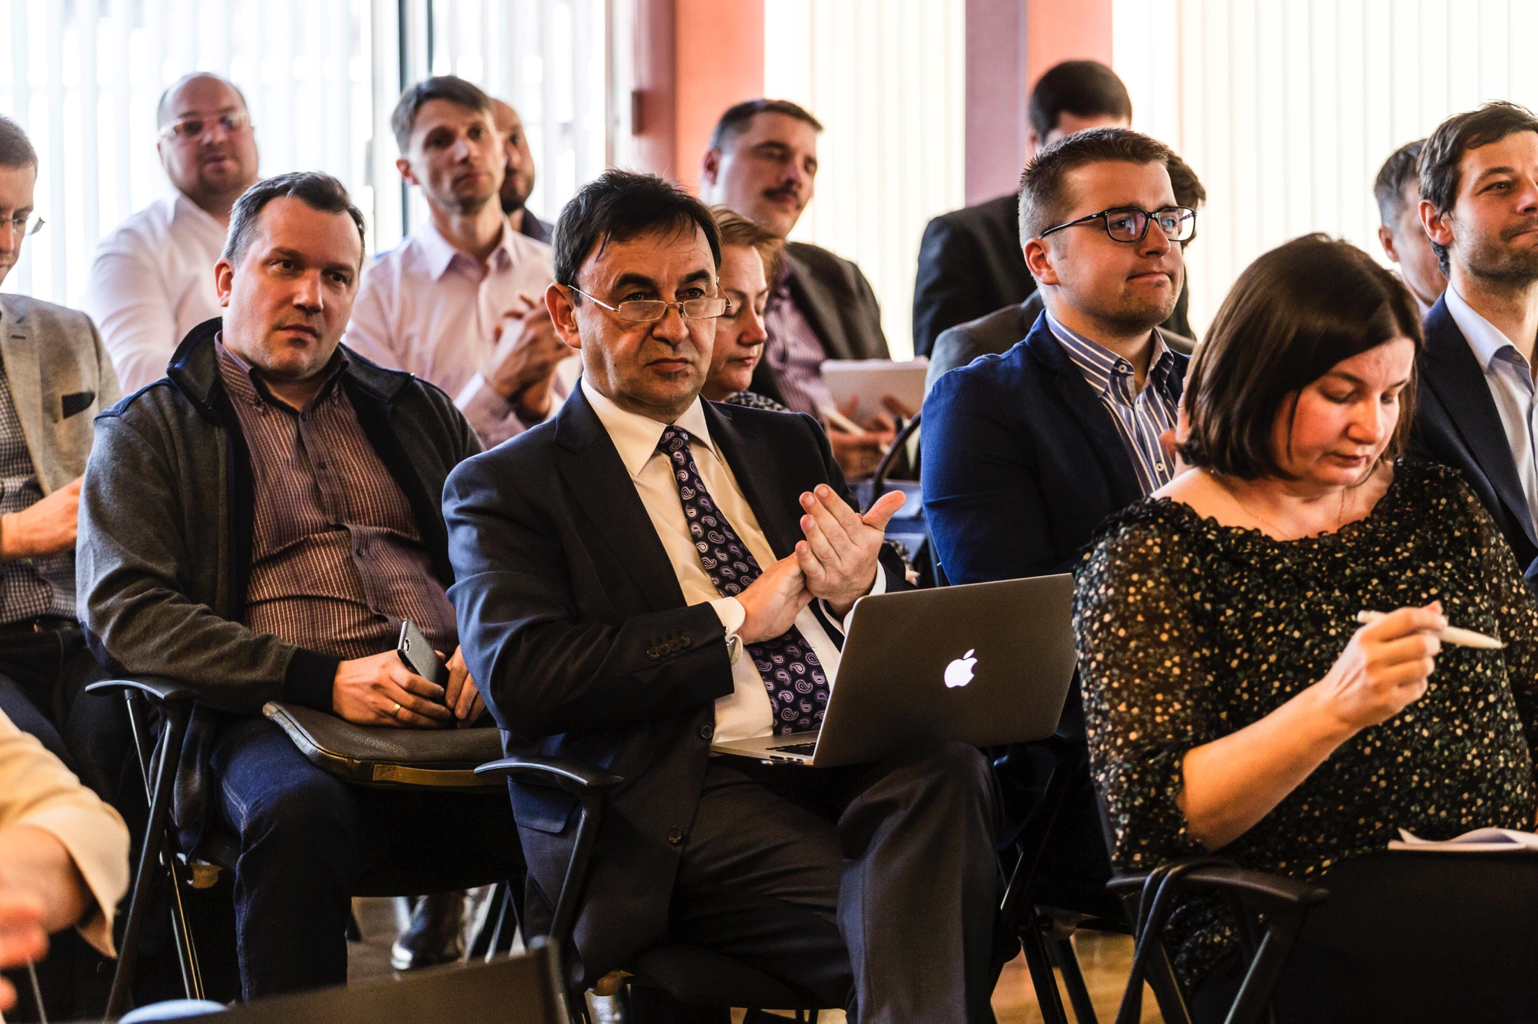

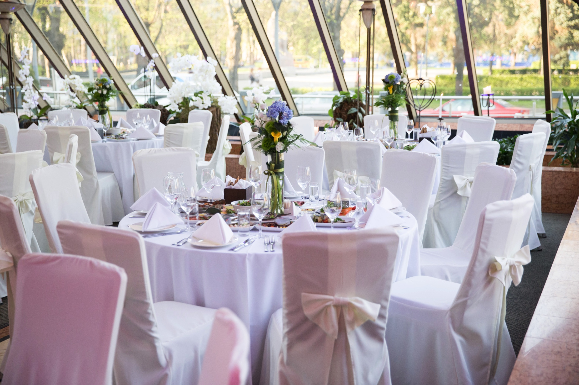
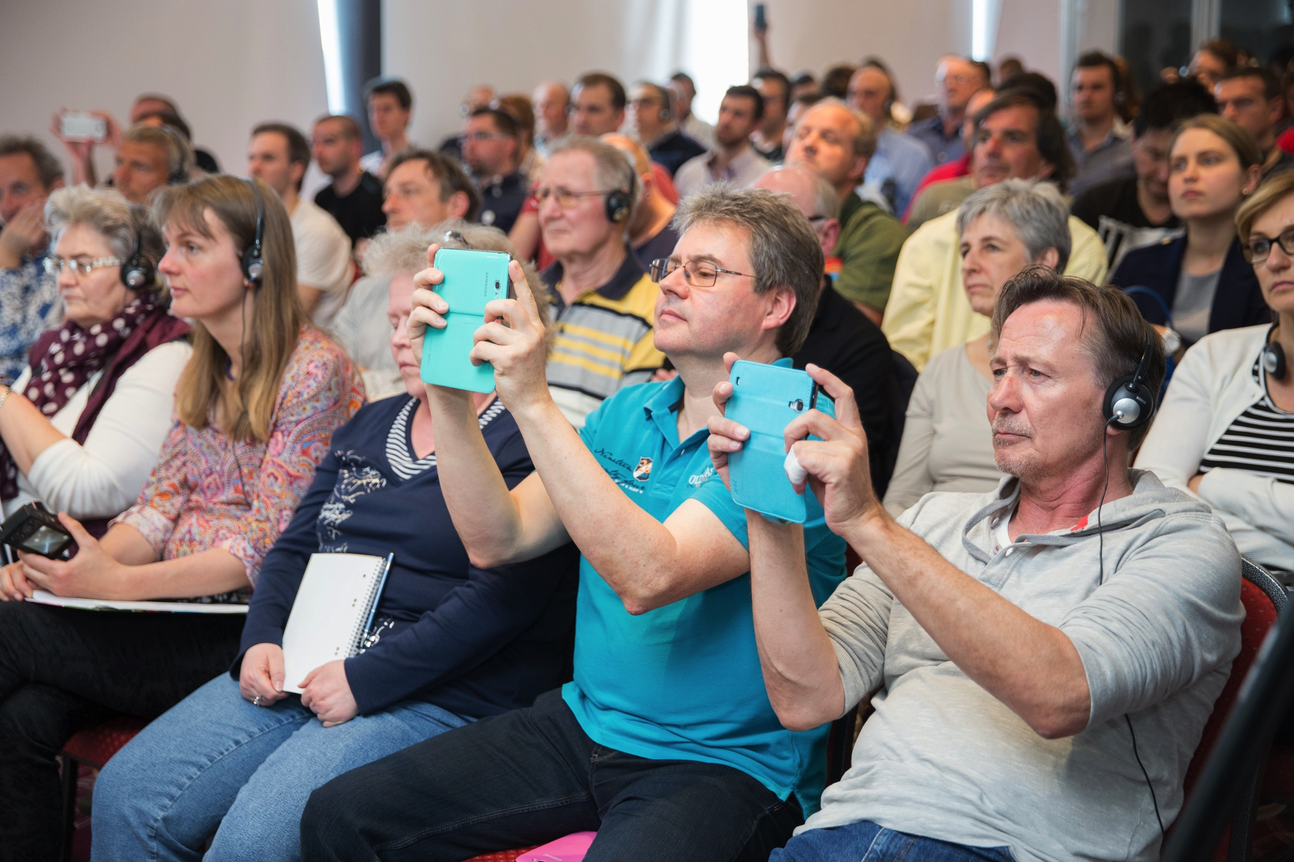
Event Management
http://event.attachebaltique.com/eng

Slide 7

We are your Personal Assistant in the Baltic States!
More information: http://www.attachebaltique.com

