Slide 1

the
Canadian Chamber of Commerce in Latvia
(CanCham)

Slide 2

February 23rd, 2017
Latvia
FIRST
to ratify
CETA
The Comprehensive Economic and Trade Agreement
between Canada and the European Union

Slide 3
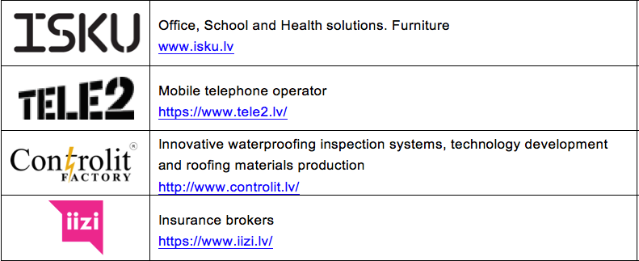
New Members

Slide 4

Join us in Celebrating Canada
As Canada prepares to celebrate it’s 150th birthday
June 5th, Monday, 18.30
Radisson Blu Latvija Conference & Spa Hotel
  With H.E. Alain Hausser, the Canadian Ambassador to Canada
  and recognizing our connections to Canada
Then on
July 1st, Saturday – The CanCham celebrates Canada’s 150th birthday
at the Trompete Restaurant.

Slide 5


Slide 6
Canada Trip
September 13th to 20th, 2017
CERBA
ventureLab
Latvian Centre
Business partners

Slide 7
Sustainability Study
Determine CanCham’s
Staffing, office and budget requirements
for presentation to the AGM
Chaired by Daiga Štendenberga
Member input welcome

Slide 8
Membership Levels
Others
€2,000
€800
Corporate Contributing €1,000
Senior Corporate €500
Corporate €200
Business €100
Individual €50
Associate €10

Slide 9
Senior Corporate Benefits
Banner - priority
Logo in priority web-site location (limited number)
Logo in CanCham presentations (limited number)
May display roll-up banner at CanCham events
Logo priority in sliding left banner
2 Special announcements sent to the entire CanCham database per year
Priority seating at events
Web site priority level

Slide 10
Introducing
RAIL BALTICA – PROJECT OF THE CENTURY
Baiba A. Rubesa
Chairperson, Management Board
RB Rail AS

Slide 11
Company presentation
IIZI Brokers
Lauris Klavins
Head of Sales, Int’l Business Development
www.iizi.lv

Slide 12
The Canadian Chamber of Commerce in Latvia
welcomes
active participants

