Slide 1





the
Canadian Chamber of Commerce in Latvia
(CanCham)
Celebrating Canada!
Guest speaker H.E. Alain Hausser,
the Canadian Ambassador to Latvia
Senior Corporate
Member
Event
Sponsor

Slide 2
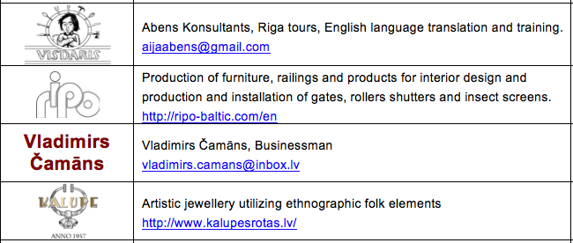
New Members
Senior Corporate
Member
Event
Sponsor

Slide 3
Upgrade to Senior Corporate Level
www.singhs.lv
The CanCham’s first Senior Corporate member
Senior Corporate
Member
Event
Sponsor

Slide 4
Event Sponsor
www.rbirojs.lv
Senior Corporate
Member
Event
Sponsor

Slide 5

Upcoming Events
June 16th, Friday, 15.00 – Celebrating Latvia, a plant tour of the Brālis Brewery
July 1st, Saturday, 14.00 – Canada Day, CanCham celebrates Canada’s 150th birthday at the Trompete Restaurant.
July 24th, Monday, 18.00 – Business After Hours at Air Baltic.
September 6th, Wednesday - Business After Hours at Circle-K with the NCCL.
Senior Corporate
Member
Event
Sponsor

Slide 6
Canada
September 13th to 20th, 2017
CERBA
ventureLab
Latvian Centre
Business partners
Senior Corporate
Member
Event
Sponsor

Slide 7
CanCham Sustainability Study
Determine CanCham’s
Staffing, office and budget requirements
for presentation to the AGM
Chaired by Daiga Štendenberga
Member input welcome
Senior Corporate
Member
Event
Sponsor

Slide 8
Introducing
H.E. Alain Hausser
the Canadian Ambassador to Latvia
Senior Corporate
Member
Event
Sponsor

Slide 9
The Canadian Chamber of Commerce in Latvia
welcomes
active participants
Senior Corporate
Member
Event
Sponsor

