Slide 1

the
Canadian Chamber of Commerce in Latvia
(CanCham)

Slide 2
Corporate
Grand Palace Hotel
PK Serviss
E-bags
Steinart Consulting
BioMark
Vaderstad
OBERONING
Welcome
and we welcome – new members
Business
OTIC
Individual
Geneval Capital
ALLIKS un PARTNERI
Ozollapas
Smart Continent LV Ekoterm
Baltijas Helikopters
Building & Renovation
Riga Candles

Slide 3
Established 1999
5 months old

Slide 4
The CanCham’s main objective to promote the business interests of its members
We want to be reliable partners locally internationally and we want everyone to know it

Slide 5
The CanCham’s main programs
Partnering for Profit
Governance

Slide 6
Main Tool
Cluster

Slide 7
Customer’s requirement
THE
CLUSTER
(CanCham)
solution for customers ☺

Slide 8
Key Points being considered
1+1=3+
How we can earn money in the end of day

Slide 9
Networking Levels
amongst members,
with member networks and other chambers and professional organizations/associations,
with Canadian counterparts,
with counterparts in other countries that are linked to our members.

Slide 10
What we will do together:
present our products/services,
discuss how we will promote our products/services with each others involvement,
use work groups of related products/services to develop strategies,

Slide 11
An important vehicle
The CanCham
Web site

Slide 12


Slide 13


Slide 14

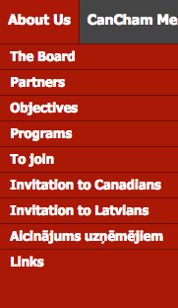

Slide 15
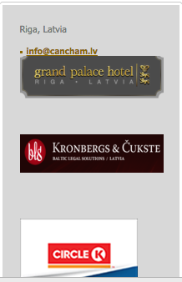
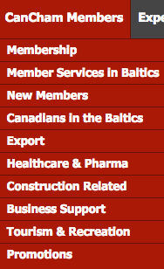

Slide 16
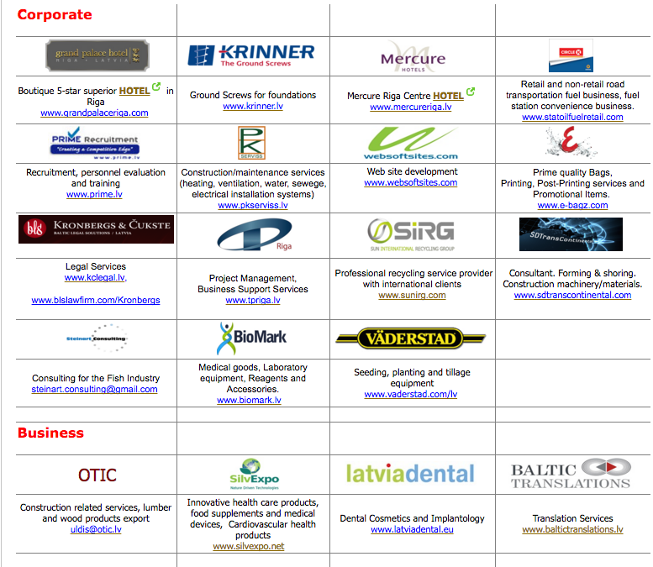

Slide 17
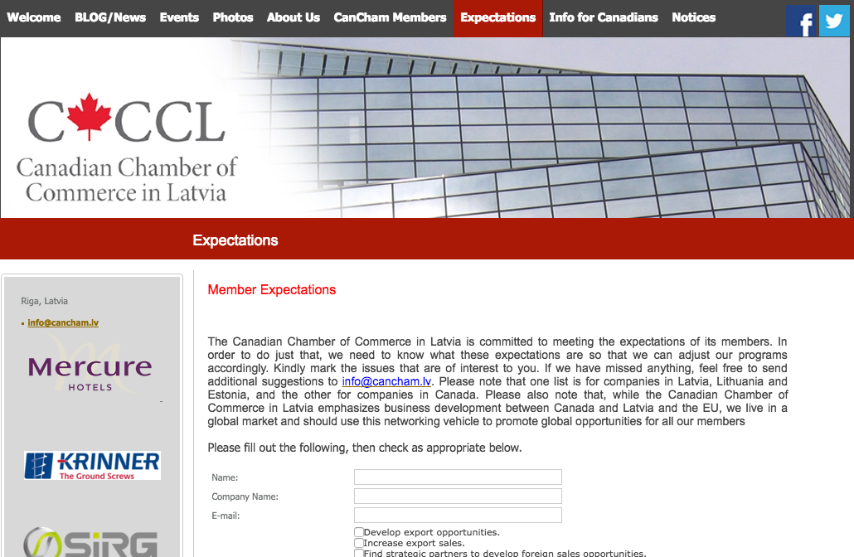

Slide 18
The Canadian Chamber of Commerce in Latvia
welcomes
active participants

Slide 19
March 24th, Thursday at 15.00
Economic Freedom Seminar at the Riga Business School
March 30th, Wednesday at 16.00
Partnership for Profit program orientation for members
April 12th, Tuesday at 18.30 - Statoil Fuel & Retail presentation on re-branding to Circle-K.
Upcoming Events

Slide 20
Introductions
Your Name
Your Company a few words about services provided

