Slide 1

Technical Partners
Business Support Services
Presentation for the
Canadian Chamber of Commerce in Latvia
March 22nd, 2016
Technical Partners International Inc. / “TP Riga” SIA
CANADA • LATVIA • CHINA • DUBAI • INDIA • SAUDI ARABIA • TURKEY • UNITED KINGDOM

Slide 2
Technical Partners
How to
Present
Investment Project Ideas
Technical Partners International Inc. / “TP Riga” SIA
CANADA • LATVIA • CHINA • DUBAI • INDIA • SAUDI ARABIA • TURKEY • UNITED KINGDOM

Slide 3
Investment Project Stages
Introduction
Business Plan Executive Summary
Memorandum of Understanding
Business Plan
Due Diligence
Contract
Technical Partners International Inc. / “TP Riga” SIA
CANADA • LATVIA • CHINA • DUBAI • INDIA • SAUDI ARABIA • TURKEY • UNITED KINGDOM

Slide 4
Introduction = Sell Sheet
Business Plan Executive Summary = Information Memorandum
Memorandum of Understanding
Technical Partners International Inc. / “TP Riga” SIA
CANADA • LATVIA • CHINA • DUBAI • INDIA • SAUDI ARABIA • TURKEY • UNITED KINGDOM

Slide 5

Our partners in Canada
Technical Partners International Inc. / “TP Riga” SIA
CANADA • LATVIA • CHINA • DUBAI • INDIA • SAUDI ARABIA • TURKEY • UNITED KINGDOM

Slide 6
Something to think about
The first person you present a project to
is probably not the decision maker
Technical Partners International Inc. / “TP Riga” SIA
CANADA • LATVIA • CHINA • DUBAI • INDIA • SAUDI ARABIA • TURKEY • UNITED KINGDOM

Slide 7
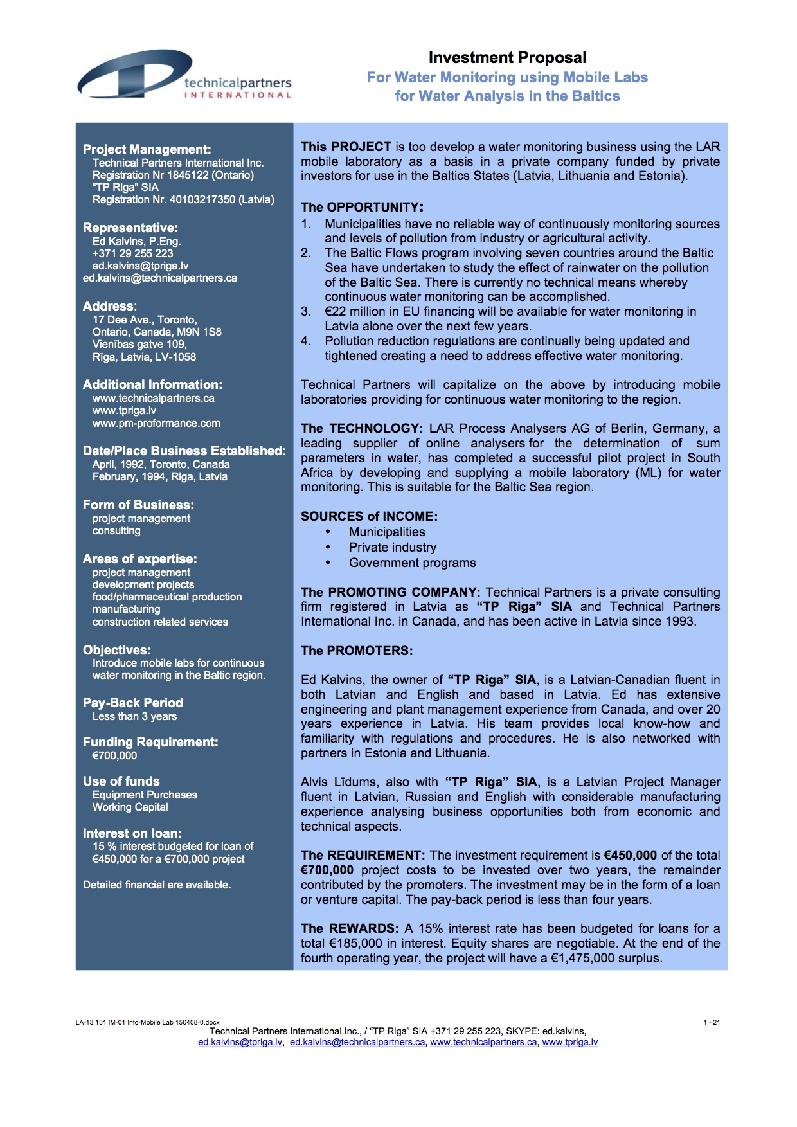
The Sell Sheet
Technical Partners International Inc. / “TP Riga” SIA
CANADA • LATVIA • CHINA • DUBAI • INDIA • SAUDI ARABIA • TURKEY • UNITED KINGDOM

Slide 8
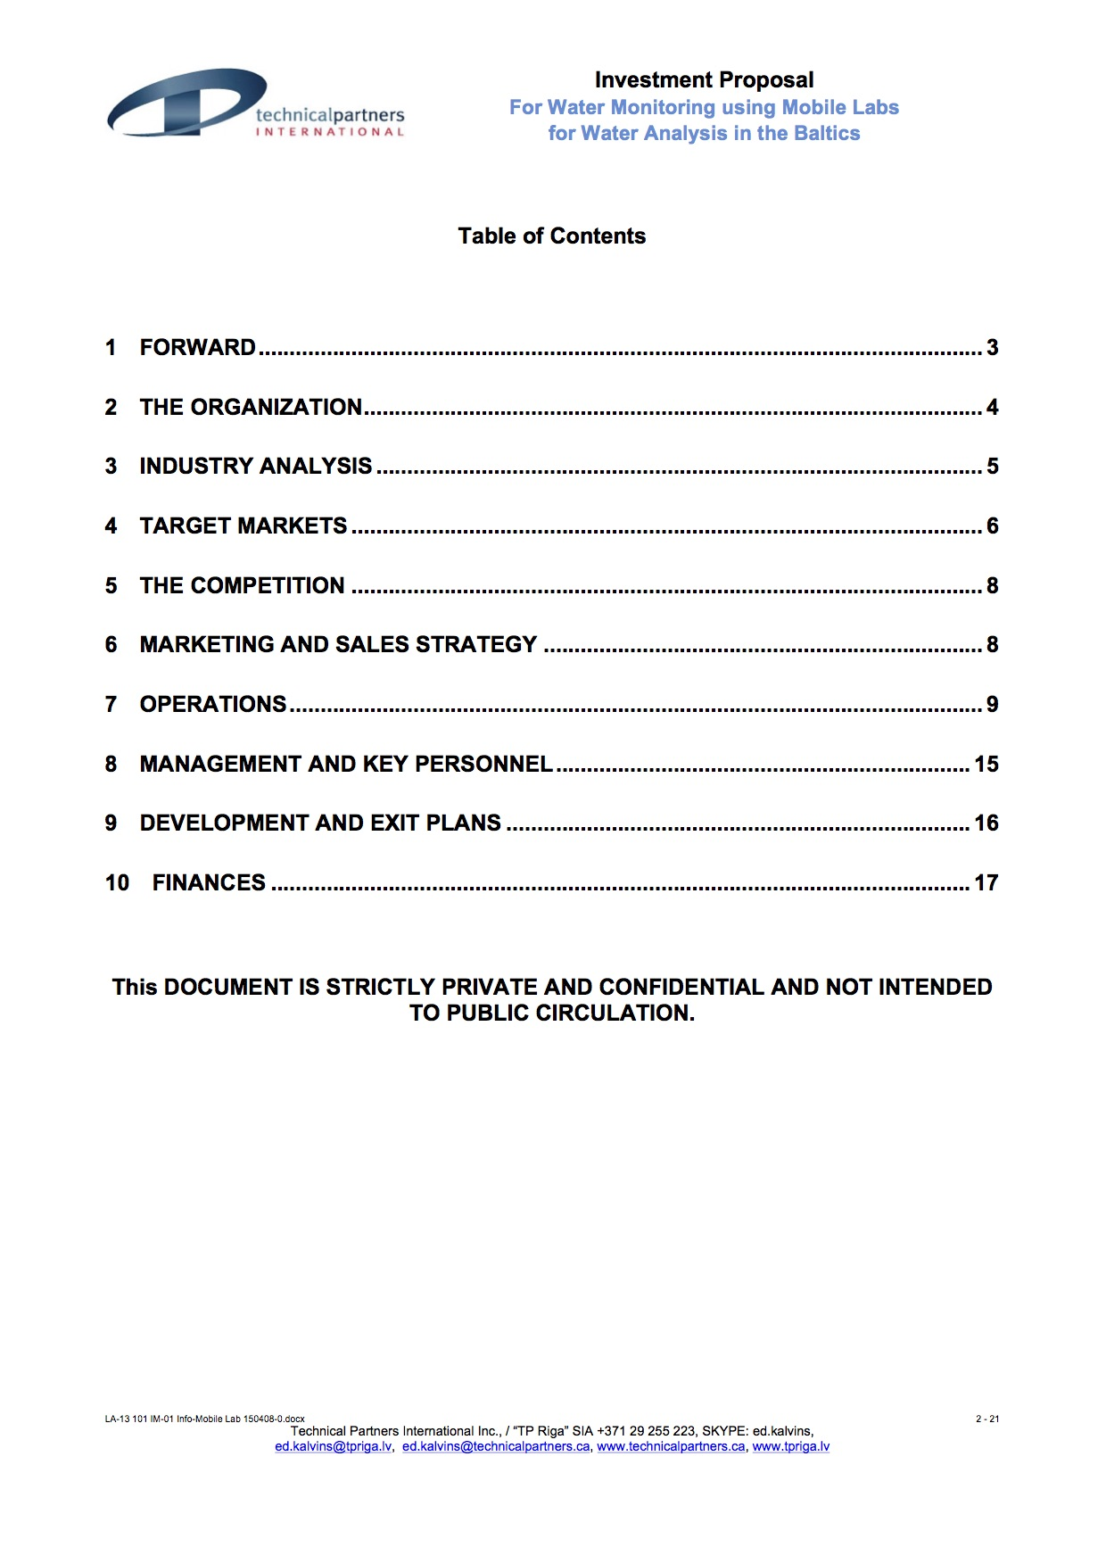
Information Memorandum
Technical Partners International Inc. / “TP Riga” SIA
CANADA • LATVIA • CHINA • DUBAI • INDIA • SAUDI ARABIA • TURKEY • UNITED KINGDOM

Slide 9
MOU
If you have to lose
Lose quickly
Technical Partners International Inc. / “TP Riga” SIA
CANADA • LATVIA • CHINA • DUBAI • INDIA • SAUDI ARABIA • TURKEY • UNITED KINGDOM

Slide 10
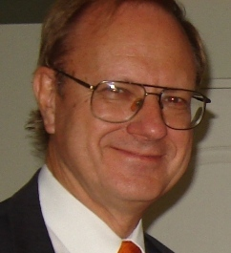
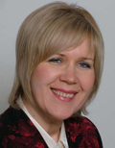
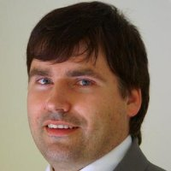

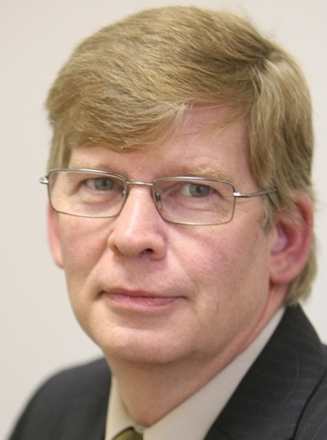

Technical Partners
Personnel
www:/tpriga.lv/our-team
Ed Kalvins
Project Manager
Inguna Gustava
Business Development
Ilvars Petersons
Sales Director
Indra Sproģe-Kalviņa
Administration/Finance
Alvis Līdums
Project Manager
Anita Boldāne
Project Manager
Technical Partners International Inc. / “TP Riga” SIA
CANADA • LATVIA • CHINA • DUBAI • INDIA • SAUDI ARABIA • TURKEY • UNITED KINGDOM

Slide 11
Thank you for your attention!
Kontaktinformācija:
Edvīns Kalviņš
SIA “TP Riga”
Technical Partners International Inc.,
ed.kalvins@tpriga.lv
+371-29-255-223
SKYPE: ed.kalvins
Mēs - ne tikai vadam projektus …
Mēs - ieviešam kārtību!
We not only manage projects ....
We create order!
Please visit us at
www.tpriga.lv
www.technicalpartners.ca
www.pm-proformance.com
Technical Partners International Inc. / “TP Riga” SIA
CANADA • LATVIA • CHINA • DUBAI • INDIA • SAUDI ARABIA • TURKEY • UNITED KINGDOM

