Slide 1
Presentation skills
Tips & Tricks
Anita Zorgenfreija

Slide 2
Notes:
Ampple example

Slide 3
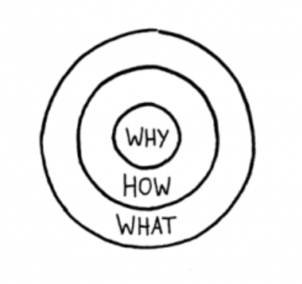

Slide 5
Customer centred business
Customer oriented product/service design
NABC
Lean canvas
Head-Heart-Coitus

Slide 6
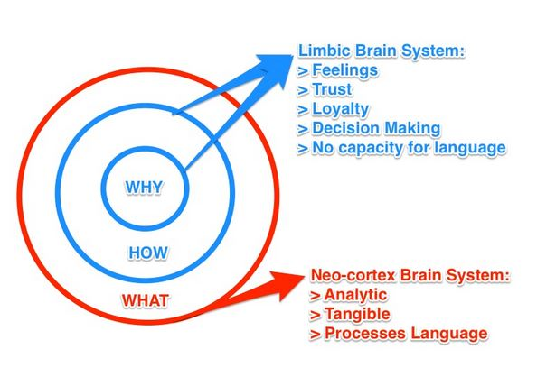
How to attract customers?
First impression
Show up to give not to take
Body language
Interaction with audience
Ignore naysayers
Turn nervousness into excitement

Slide 7
How to pitch your product/service?
10 – 20 – 30
10 slides
30 point font size
20 minutes
[Guy Kawasaki]

Slide 8
What to put in 10 slides?
Title
Problem
Solution
Business model
Underlying magic
Marketing&sales
Competition
Team
Projections
Status&timeline

Slide 9
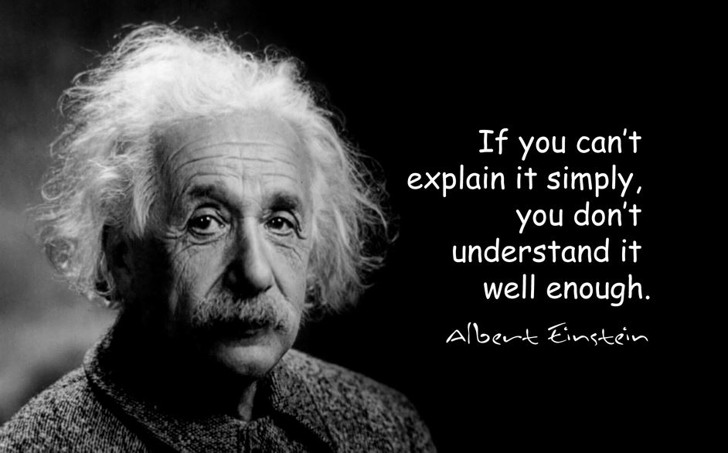

Slide 10
Appearance of presentation
Less is more!
Meaningful pictures
You should explain every word and number
Simple (corporate) design – colors/fonts
Just 1 type of slide transitions
Avoid distractions
Early bird price only $95

Slide 11
Thank you!
Anita Zorgenfreija
Notes:
Ampple example

