Slide 1
Riga and Architecture
Gvido Princis
Riga City Architect
CanCham Business Development Forum - Development Opportunities and Business Environment in Riga
15.06.2016. Riga
Grand Palace Hotel, Pils iela 12

Slide 2
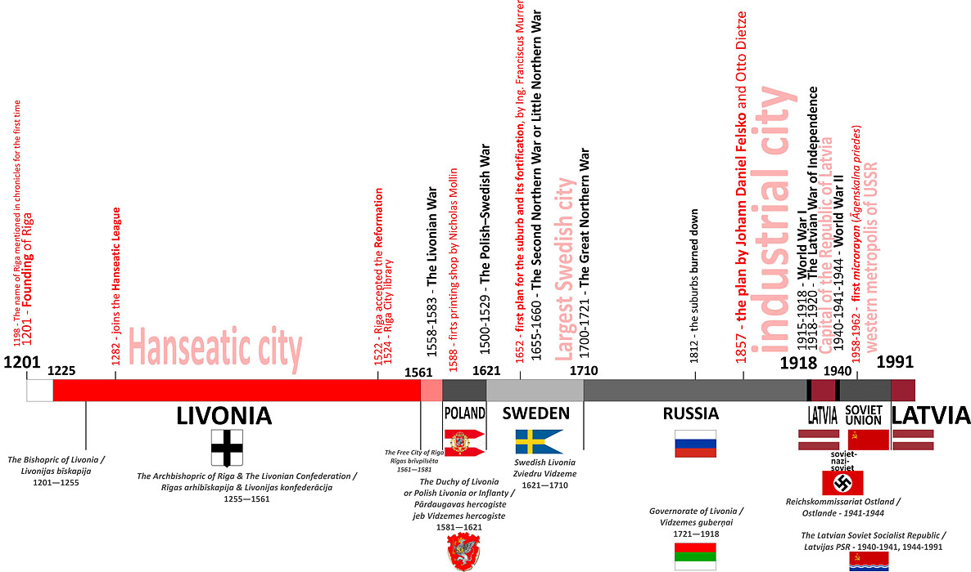
History
© Artis Zvirgzdiņš

Slide 3
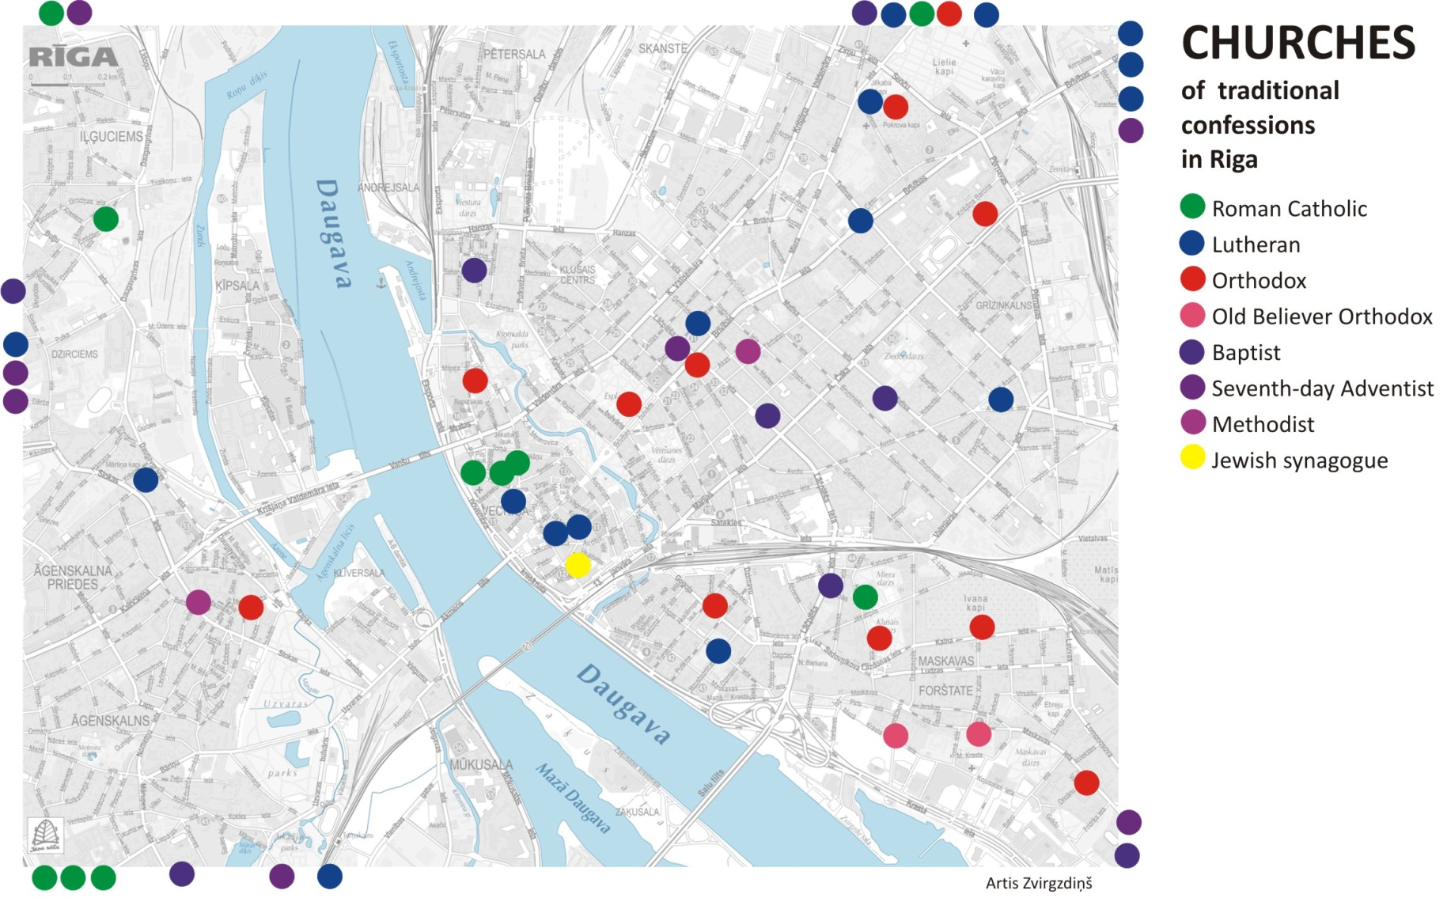
Multiculturality
© Artis Zvirgzdiņš

Slide 4
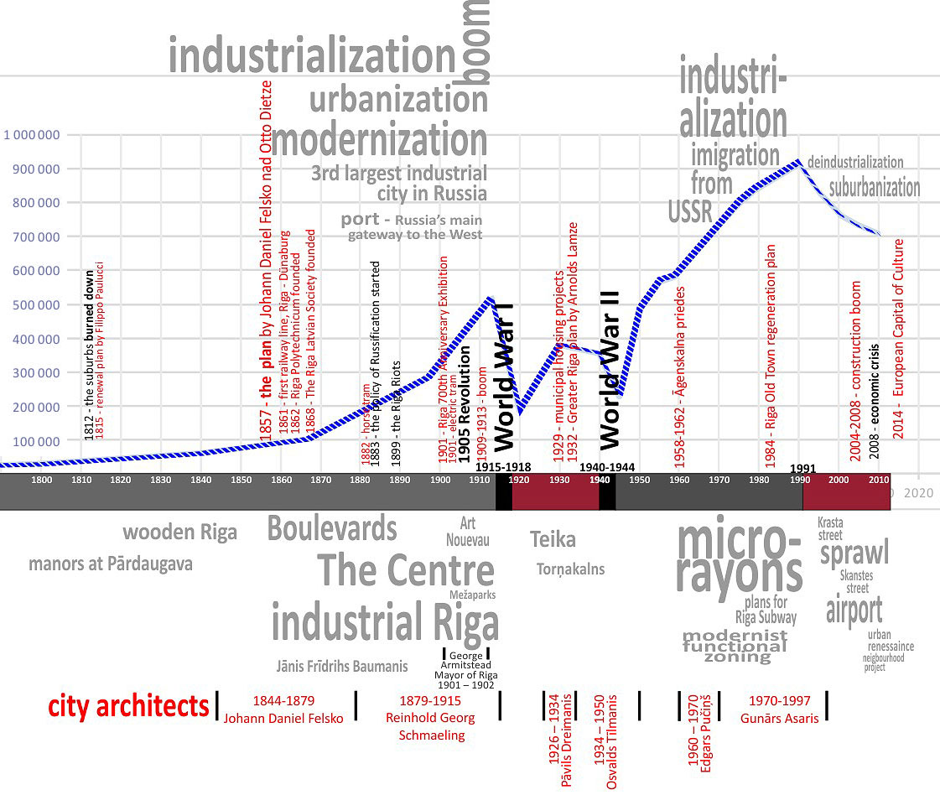
Urbanisation
Old Riga
© Artis Zvirgzdiņš

Slide 5
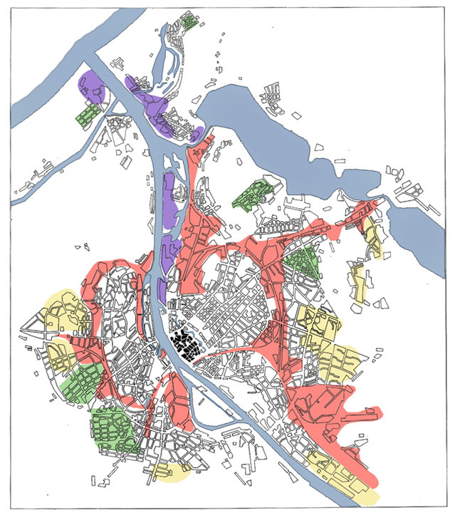
Urban Structure
City Centre
Old Town
Low rise residential
Micro rayon
Industry
Port
according to Sigvards Grava, Irēna Bākule
© Artis Zvirgzdiņš

Slide 6
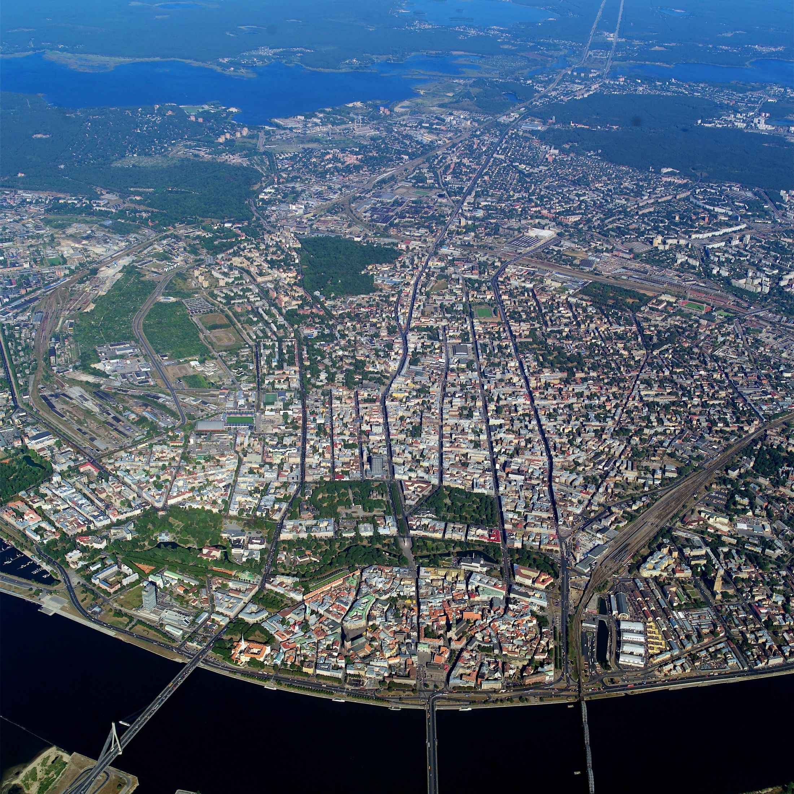
Byferzone
Riga Historical Center
Riga Historical Centre –
UNESCO World Heritage Site
Notes:
Часть центра города была включена в список мирового наследия UNESCO.
Старая Рига и часть центра города внесен в 1997. году. Площадь градостроительного памятника 438 гектар (4,38 квкм).
Наиболее значимымими являются:
-средневековый город
-периметральная застройка центра и бульварнео кольцо
-Югендстиль
-Деревянная архитектура

Slide 7
Important
Best development projects are based on deep understanding of Riga context (social and physical)
Municipality of Riga develops an instruments to secure values and increase quality of development projects
R&D in close collaboration with industry and universities
Notes:
Both – social and physical

Slide 8
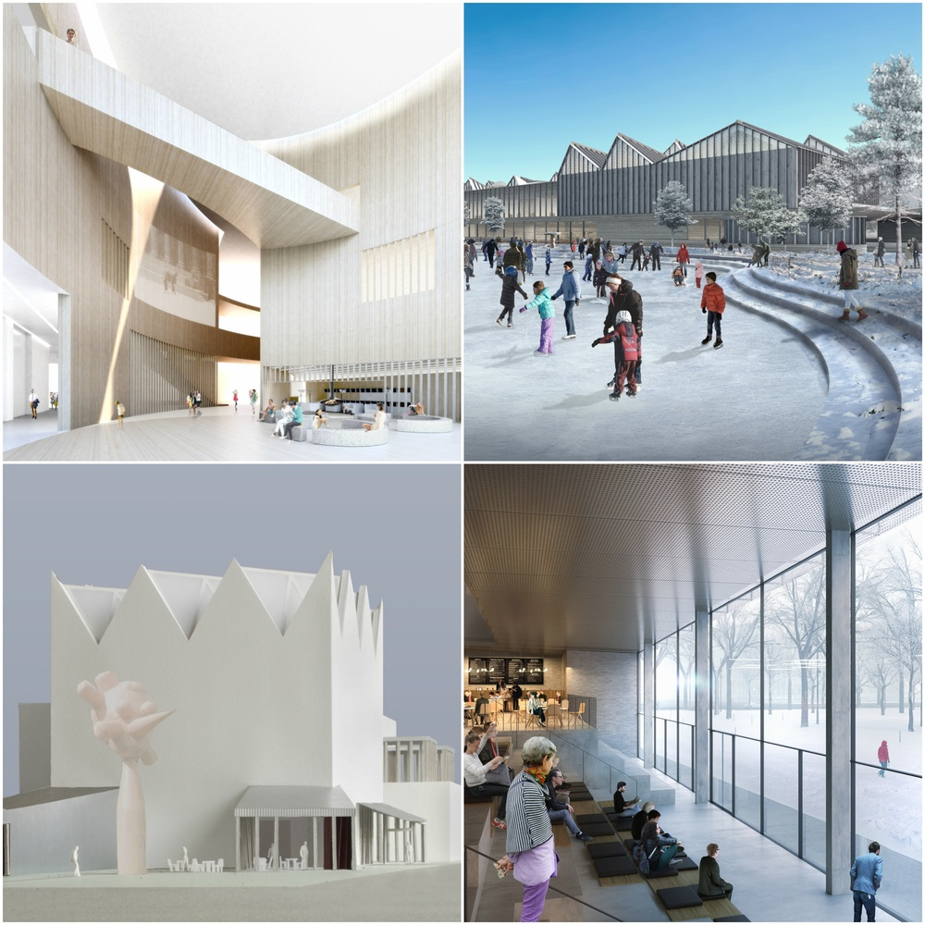
Oportunities
The Latvian Museum
of Contemporary Art
The design proposals
of seven shortlisted
International arhitect
teams have been released)
Notes:
by the competition’s organizer, Malcolm Reading Consultants. Located in the capital city of Riga, the funding for the €30 million project is a public private partnership with support from from the ABLV Charitable Foundation and the Boris and Ināra Teterev Foundation, which co-founded the Latvian Museum of Contemporary Art Foundation

Slide 9
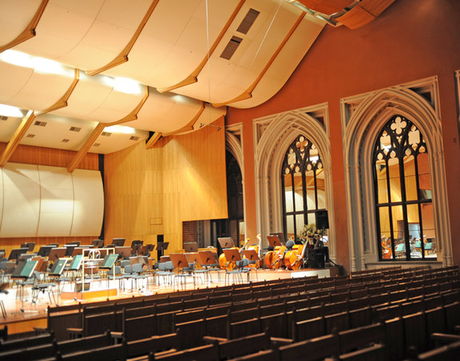
Oportunities
ACOUSTIC CONCERT HALL and CONFERENCE CENTER IN RIGA
Discussion yesterday in
Riga city architect’s office :
"There are lots of different
discussions necessary for
this project - what sort of
hall should it be, with what
sort of parameters for musicians,
the audience, industry,
business, and should it
be local or international in
scale? These questions
are all relevant to the
discussion."

Slide 10
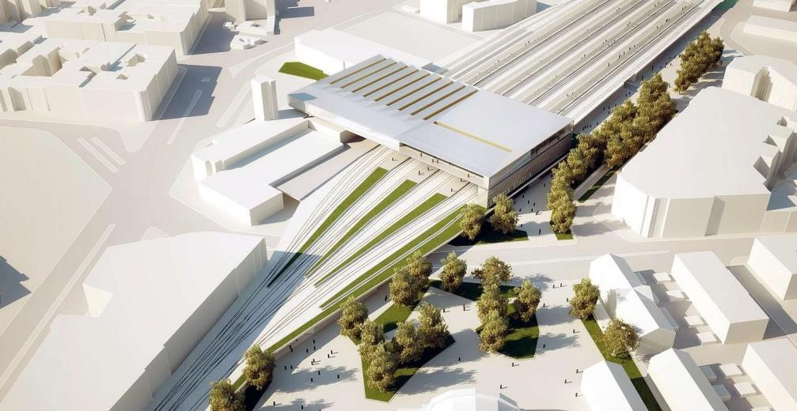
Oportunities
Rail Baltica – fast and environmentally friendly rail connection to Europe

Slide 11
Thank you!
Questions/ Comments
Gvido Princis
Riaga City Architect
Dzirnavu str. 60 A-21,
Rīga, LV-1050, Latvia gvido.princis@riga.lv +371 67105937 pilsetasarhitekts.riga.lv
facebook.com/RigasPilsetasArhitekts

