Slide 1

the
Canadian Chamber of Commerce in Latvia
(CanCham)

Slide 2

Exports
Investments
Strategic Partners

Slide 3
Kārlis Eihenbaums
Latvian Ambassador designate to Canada
Arvils Zeltiņš
Ministry of Foreign Affairs, Head of the Foreign Economic Relations Promotion Department
Mark Deiton
Latvian Embassy in Canada First Secretary designate responsible for promotion of business, trade and investment

Slide 4
H. E. Alain Hausser
Canadian Ambassador to Latvia
Honorary Chairman of the Canadian Chamber of Commerce in Latvia
Irena Cirule
Commercial Officer, Canadian Embassy in Latvia
Director (CanCham) - Liaison with Canadian Embassy

Slide 5
Established 1999
9 months old
Strategy change to take advantage of a once in a life time opportunity

Slide 6
CETA
the
Comprehensive
Economic and Trade
Agreement
(Canada/European Union free trade agreement)

Slide 7
Terms agreed
Ratification expected within a year

Slide 8
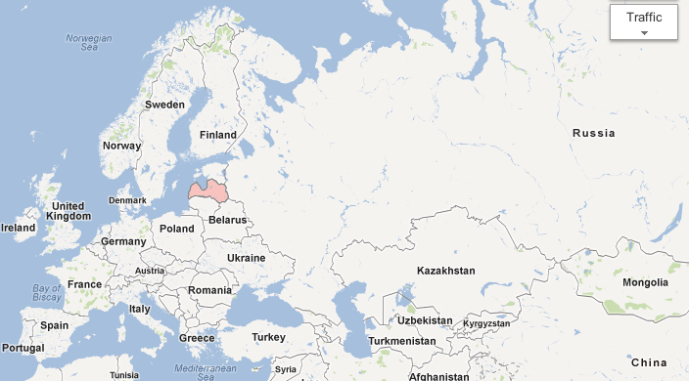
  Latvia is positioned for potential
Population:
Russia 142.9
Ukraine 45.9
Belarus 9.5
Total East 198.3
Population:
Total EU 499.8
Canada/US 345.8

Slide 9
For Latvians exporting products, services or innovations to Canada increasing export sales to Canada finding strategic partners from Canada for development projects or investments providing services to Canadian companies doing business in Latvia representing Canadian companies in Latvia or the Baltic region

Slide 10
For Canadians exporting products or services to Europe increasing export sales to Europe finding strategic partners for development projects or investments in Northern Europe finding strategic partners who will assist to enter the Russian and Central Asian markets representing Northern European companies in Canada providing services to Northern European companies doing business in Canada

Slide 11
Our Challenge presenting what we have to offer and what we can do developing contacts selling, doing business and making money

Slide 12
The secret to success
is
talking to each other
Networking

Slide 13

Networking

Slide 14
Networking

Slide 15












Networking

Slide 16


Networking

Slide 17



Partners

Slide 18
The CanCham is preparing its members to take advantage of the opportunity

Slide 19
Programs
Partnering for Profit
Helping one another find clients
Governance
Addressing troublesome regulations

Slide 20
Events to develop an understanding on how to achieve results
“CETA – the EU-Canada Free Trade Agreement” - January
Financing Development - March
Creating Visibility - May
Development Opportunities and Business Environment in Riga - June

Slide 21
CETA the EU-Canada Free Trade Agreement
January 14th, 2016 with
Artis Pabriks the European Parliament Member appointed as the EP's chief rapporteur on the EU-Canada free-trade agreement (CETA).
CETA is particularly significant to small and medium businesses as it not only eliminates most tariffs, but it also simplifies procedures that smaller companies have not been able to afford to deal with in the past to enter these markets.

Slide 22
Financing Development
March 22nd, 2016 with
Altum
Investment and Development Agency of Latvia (LIAA)
Imprimatur Capital Fund Management
Technical Partners

Slide 23
Creating Visibility
Thursday, May 26th, 2016 with
STENDERS
Canadian Embassy in Latvia
Anita Zorgenfreija
“Prime Recruitment” SIA

Slide 24
Development Opportunities and Business Environment in Riga
June 15th, 2016 with
Gvido Princis - Riga City Architect
Jānis Prūsis - Investment Division of the Riga City Development Dep't

Slide 25
Understanding Canada
Regions
Maritimes
Quebec
Ontario
Praries
British Columbia the North

Slide 26
Kārlis Eihenbaums
Latvian Ambassador designate to Canada

Slide 27
Arvils Zeltiņš
Ministry of Foreign Affairs,
Head of the Foreign
Economic Relations Promotion Department

Slide 28
Mark Deiton
Latvian Embassy in Canada
First Secretary designate
responsible for promotion of business, trade and investment

Slide 29
Participant Introductions
Company’s product or service
What would you like from Canada?
Suggest how our Embassy can help

Slide 30
The Canadian Chamber of Commerce in Latvia
welcomes
active participants

