Slide 1
the Canadian Chamber of Commerce in Latvia (CanCham)

Slide 2
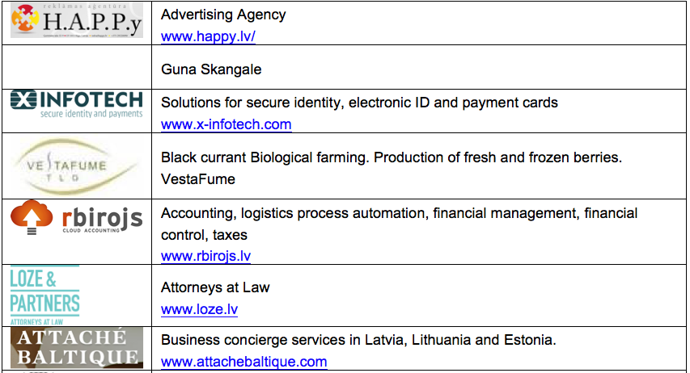
New Members

Slide 3
Special Visitor
Rajiv Asthana
MASE Exim Private Limited (India)
MASE Exim Pvt. Ltd. (U.A.E.

Slide 4
Special Guests
Andris Piebalgs (Chairman of the Unity Party - Vienotība)
Ilvars Pētersons (General Manager, Siemens Osakeyhtiö Latvian Branch)

Slide 5
Event Calendar
September 14st, Wednesday, 16.00 – Partnership for Profit program orientation
September 28th, Wednesday, 16.00 – Partnership for Profit program orientation
October 3rd, Monday, 18.30 - Annual General Meeting
October 10th, Monday – Canadian Thanksgiving Dinner
November 3rd, Thursday - Partnering for Profit program Theme: “Getting the message out”.

Slide 6
Annual General Meeting (AGM) October 3rd, 2016
The following are to be elected:
Chairman of the Board (1)
Members of the Board (4)
Audit Committee members (3)

Slide 7
Upcoming Activities
Presentations by members
Governance work group
Work groups by category (construction, business support, etc.)

Slide 8
Presentations
Smart Continent LV Ekoterm SIA - Gints Turlajs
Areto Development - Arvīds Godjuks
SIA "Stendenberga" representing KRINNER - Daiga Štendenberga
E-bags. - Jan Welitz, Andrej Nikiforov

Slide 9
The Canadian Chamber of Commerce in Latvia
welcomes
active participants

Slide 10
Andris Piebalgs
Chairman – Unity Party (Vienotība)

Slide 11
Ilvars Pētersons
(General Manager, Siemens Osakeyhtiö Latvian Branch)

Slide 12
Presentation
Smart Continent LV Ekoterm SIA
Gints Turlajs

Slide 13
Presentation
Areto Development
Arvīds Godjuks

Slide 14
Presentation
SIA "Stendenberga" representing KRINNER
Ed Kalvins on behalf of Daiga Štendenberga

Slide 15
Presentation
E-bags.
Jan Welitz, Andrej Nikiforov

