Slide 1
the Canadian Chamber of Commerce in Latvia (CanCham)

Slide 2
Board of Directors elected at the October 3rd AGM
Ed Kalvins, President
Jānis Loze, Vice-President
Indra Sproģe-Kalviņa, Director, Finance & Administration
Henrik Mjoman, Director, Business Development
Daiga Štendenberga, Director
Sam Davidovich, Director – Canada

Slide 3
Audit Committee elected at the October 3rd AGM
Dzintra Renigere
Jan Welitz
Arvids Godjuks

Slide 4
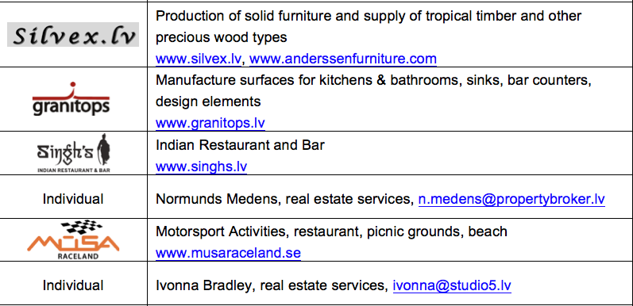
New Members

Slide 5
Event Calendar
November 14th, Monday 18.30 - Business Support Services work group.
November 21st, Monday - Partnership for Profit program orientation for members
November 28th, Monday, 18.30 - Construction Related
December 5th, Monday 18.30 - CanCham Christmas party. Trompete Restaurant
December 12th, Monday - Governance work group. Venue TBD.

Slide 6
CanCham Christmas December 5th, 2016, 18.30
Trompete Restaurant
Raffle in support of Foundation
“Nāc līdzās!” (Come along!)
Sponsors welcome!

Slide 8
Presentations
SilvEXPO, Uģis Klētnieks / Ilona Vanaga
Crea Promotion, Olga Melnikova
Divine Heat, Stefan Westberg
Attaché Baltique, Jelena Osipkova

Slide 9
Guest Speaker
Arvils Ašeradens
Deputy Prime Minister
Minister for Economics

Slide 10
Special Guest
H. E. Alain Hausser
Canadian Government Ambassador to Latvia

Slide 11
Presentation
SilvEXPO
Ilona Vanaga

Slide 12
Presentation
Crea Promotion
Olga Melnikova

Slide 13
Presentation
Divine Heat
Stefan Westberg

Slide 14
Presentation
Attaché Baltique
Jelena Osipkova

Slide 15
The Canadian Chamber of Commerce in Latvia
welcomes
active participants

