Slide 1
Stefan Westberg
Divine Heat Company
www.nibe.lv

Slide 2
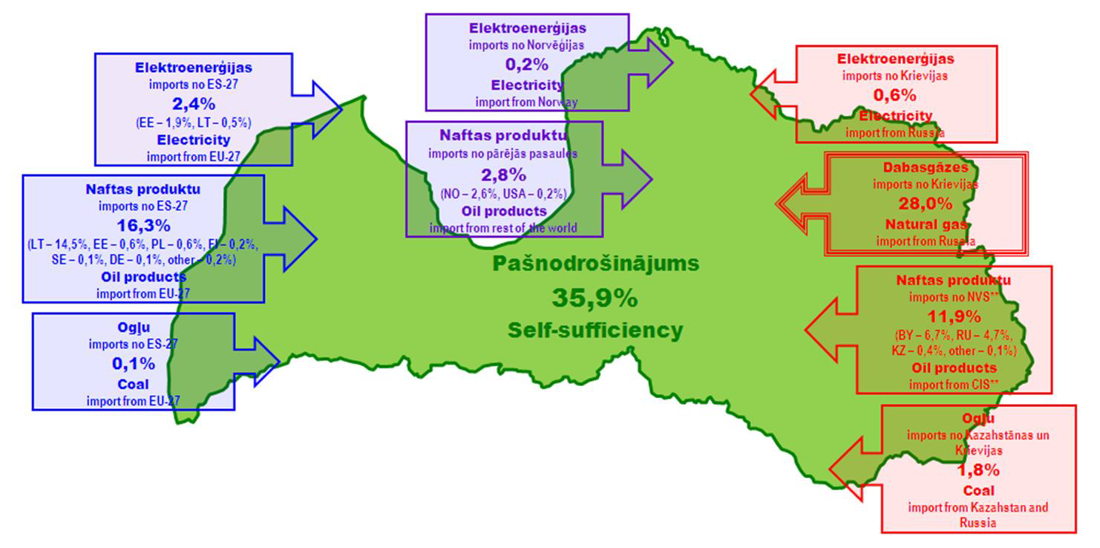
Energy self-sufficiency in Latvia
Source: Latvian Bioenergy Association

Slide 3
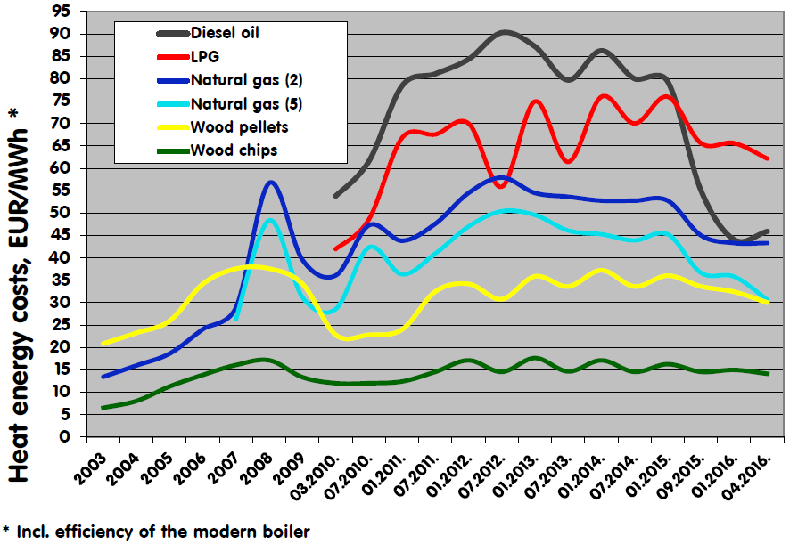
Energy costs from different fuels
Source: Latvian Bioenergy Association

Slide 4
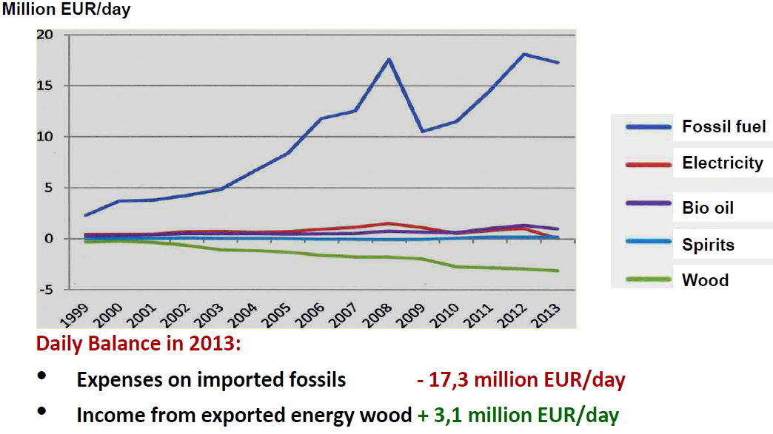
Export-Import balance of energy sources
Source: Latvian Bioenergy Association

Slide 5
Energy costs from different fuels
Source: Latvian Bioenergy Association

Slide 6
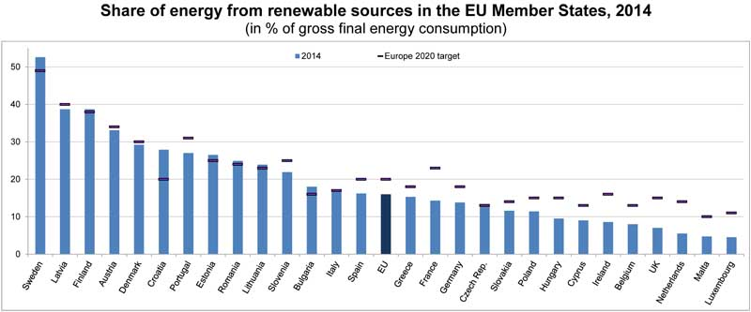
Share of energy from renewable sources 2014

Slide 7
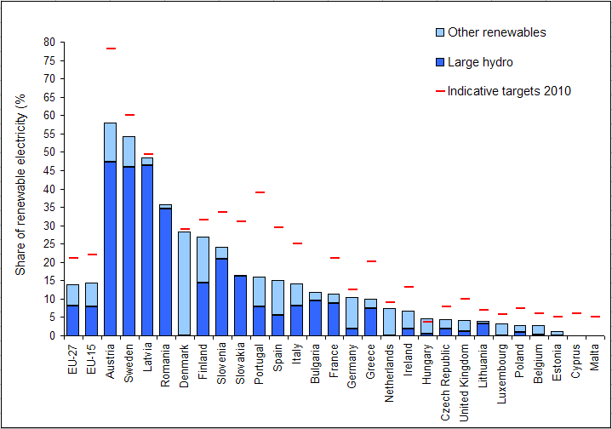
Share of renewable electricity %

Slide 8
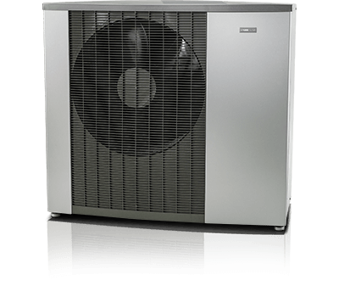
NIBE F2120

Slide 9
A+++
Our new F2120-series of air/water heat pumps represent a real breakthrough in housewarming with a SCOP-value of more than 5.0.
Or in other words; the pumps deliver more than five times as much heat, on an annual basis, as an electric heater using the same energy.
And what’s more, they have a class leading working range with a supply temperature of up to 65°C and deliver an amazing 63°C at ambient temperatures as low as -25°C.

Slide 10
Stefan Westberg
Divine Heat Company
www.nibe.lv
t. 2646 4488

