Slide 1

the
Canadian Chamber of Commerce in Latvia
(CanCham)

Slide 2
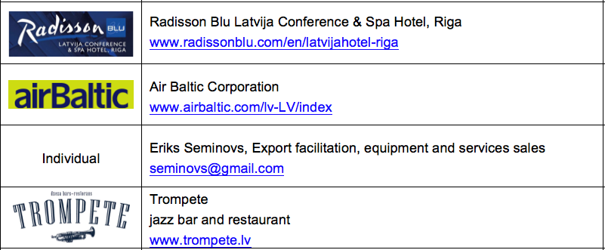
New Members

Slide 3
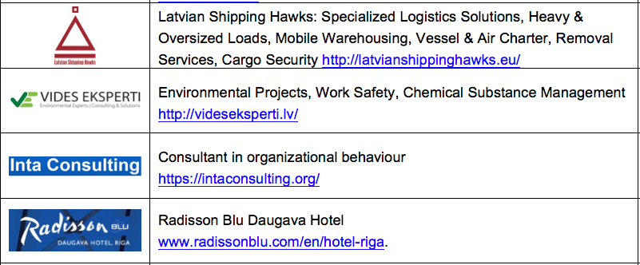
New Members

Slide 4
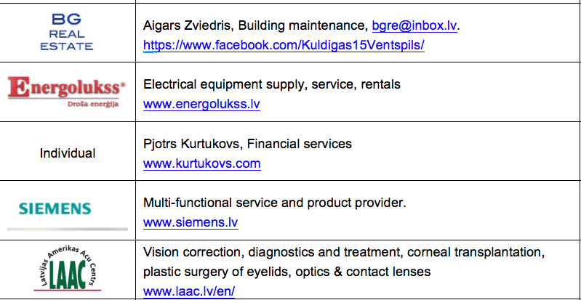
New Members

Slide 5
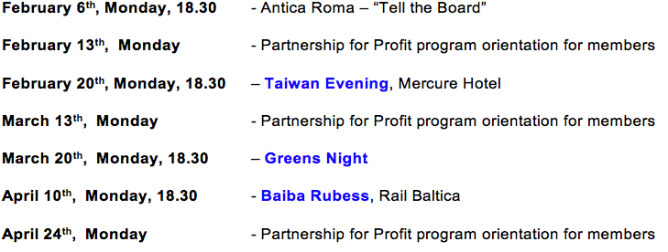
Event Calendar

Slide 6
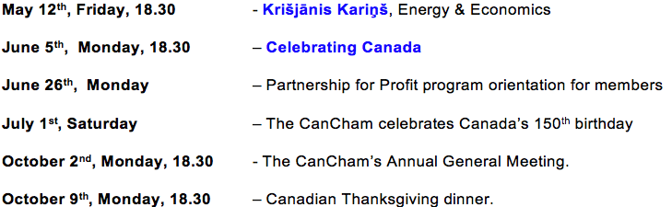
Event Calendar

Slide 7
Presentations
CanCham Work Groups, Ed Kalvins
Vides eksperti, Ivars Pavasars

Slide 8
Guest Speaker
Artis Pabriks
European Member of Parliament
EP's chief rapporteur on CETA

Slide 9
The Canadian Chamber of Commerce in Latvia
welcomes
active participants

