Slide 1
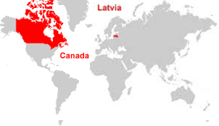
NEWS
February 2nd, Thursday, 8.30 - Radisson Blu Hotel Latvija – “Breakfest with Ms.Ilze Cirule (Director General of the State Revenue Service)”. In cooperation with the ICCL. CanCham members pay ICCL member admission rate (25 EUR), non-members - 35 EUR.
February 6th, Monday, 18.30 - Antica Roma – “Tell the Board”. An opportunity for members and guests to meet in an informal atmosphere to discuss the CanCham with the Board and just network, while enjoying genuine Italian cuisine at the same time.
February 13th, Monday - Partnership for Profit program orientation for members, Technical Partners office, Vienības gatve 109, 3rd floor, 4th office.
February 20th, Monday, 18.30 – Taiwan Evening, Ambassador R.C.Wu and Chung-Yung Keng, Deputy Head of Division of the Taipei Mission will be presenting Taiwan and business opportunities between Latvia and Taiwan at the Mercure Riga Centre Hotel, Elizabetes 101.
NEW MEMBERS January 2017
Radisson Blu Latvija Hotel
Siemens Osakeyhtio Latvija
Energolukss
Latvian American Eye Centre
BG Real Estate
Pjotrs Kurtukovs
(To join as a member, use the following link:
http://cancham.lv/about-cancham/application)
June 5th, Monday, 18.30 Celebrating Canada
Visit: www.cancham.lv/news
www.faceboo.com/
canchamlvatvia

