Slide 1
What can an environmental consultant do for you?
Ivars Pavasars
January 26th, 2017
Canadian Chamber of Commerce in Latvia

Slide 2
Your environmental partner in Latvia and in the EU
Latvian and EU environmental legislation and requirements
http://www.varam.gov.lv/lat/likumdosana/normativie_akti/
Noise, Waste, Soil, Natural resource tax, Air pollution, Packaging, Environmental impact assessment, Specially protected Nature Territories, Chemicals, Industrial pollution
…
etc. In total 22 subcategories

Slide 3
Environmental permits and reporting to authorities
A, B or C permits
Directive on industrial emissions 2010/75/EU (recast IPPC directive)
Your environmental partner in Latvia and in the EU

Slide 4
Environmental Due Diligence
Environmental audit
In North America - Phase I and II environmental site assessment
Environmental risks assessment
Environmental compliance

Slide 5
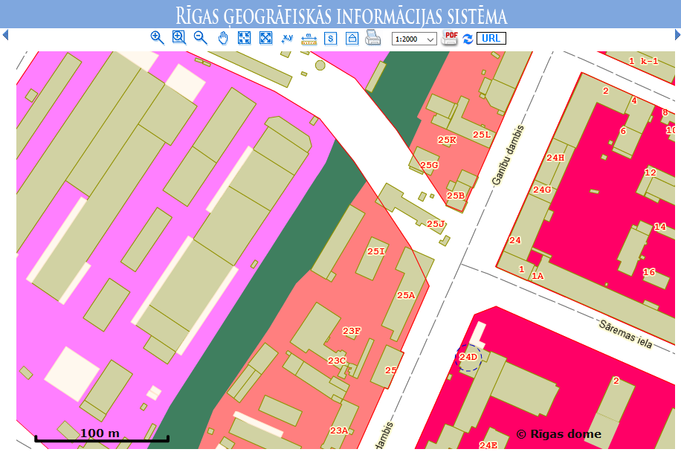
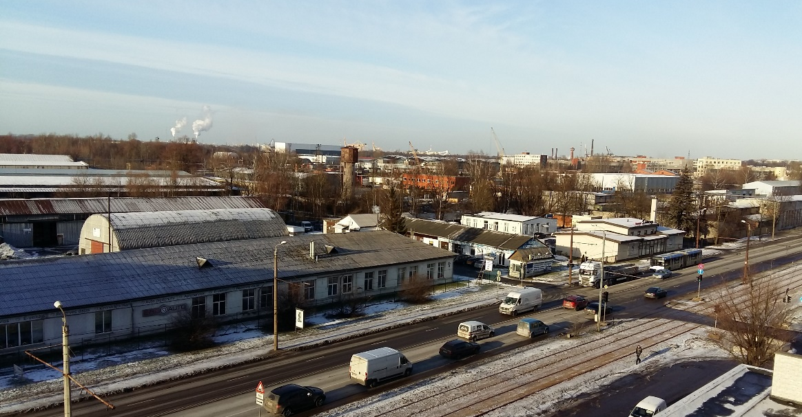
Territorial (spatial development) plan requirements

Slide 6
Environmental Impact Assessment (EIA, SEA)
Directive 2011/92/EU
on the assessment of the effects of certain public and private projects on the environment

Slide 7
Thank you for your attention!
SIA “Vides eksperti”
Ganībus dambis 24D, Rīga
birojs@videseksperti.lv
videseksperti.lv

