Slide 1
Canadian Chamber of Commerce in Latvia (CCCL)
Partnering for Profit
Presentation for the
Taipei Mission in Riga
February 20, 2017

Slide 2
Assistance offered
Supporting Taiwanese business operations in Latvia & the Baltic region
Construction related services
Finding Latvian export goods and services for Taiwan market
Helping with tourism, business travel and recreational activities
Organizing medical services and medical tourism
Liaison between Taiwanese businesses and Canadian market
Liaison between Taiwanese businesses and European Union market

Slide 3
Business Support
Setting up a business: finding real estate, staff recruitment, translation
Ongoing business support: accounting, work safety, project management
Advisory services: legal, business consulting, market research, organizational behaviour
Business promotion: marketing (IT, websites, online shopping, packaging), advertising, promotional products, outreach support (trade shows, PR)
Assistance with facilities maintenance

Slide 4
Construction Related services
Supply of construction materials, e.g., lumber, foundations
Supply of equipment, e.g., electrical & heating, furniture & fixtures
Engineering services: construction, architectural design, project management
Plant construction, e.g., for food, pharmaceuticals, sawmills, furniture
Environmental services: water management, environmental protection
Support services: logistics, warehousing, maintenance, leasing

Slide 5
Exports
Manufactured products: construction materials, furniture & fixtures, health care items, home items
Food and drink, e.g., beer, frozen foods
Technical services: energy know-how, project management, environmental services, medical services, film & art
Business support: IT & web design, shipping & warehousing, financial services

Slide 6
Travel and Recreation
Hotels and restaurants
Concierge services
Transportation: regional airline and helicopters
Assistance with business activities: trade shows, conferences, exhibitions
Organizing leisure activities: equestrian sports, motorsports, helicopter tours, hunting expeditions

Slide 7
Healthcare & Medical Tourism
Medical services: vision, dental, virotherapy, operations
Medical supplies: equipment, health care products, engineering systems
Support services: product and business development, health & safety, regulatory & compliance

Slide 8
International Networking
CCCL member ties with EU and Canadian businesses to benefit from Canada-European Union (EU) Comprehensive Economic and Trade Agreement (CETA)
CCCL Director in Toronto
CCCL participation with the Canada Eurasia Russia Business Association (CERBA)

Slide 9
What the CCCL needs
Strategic partnerships to do business in EU, Asia, Canada or Taiwan
Investment and strategic partnerships for development projects
Partners for increasing export sales to the European markets
Representatives for Latvian businesses in Taiwan
Service providers to Latvian businesses in Taiwan

Slide 10
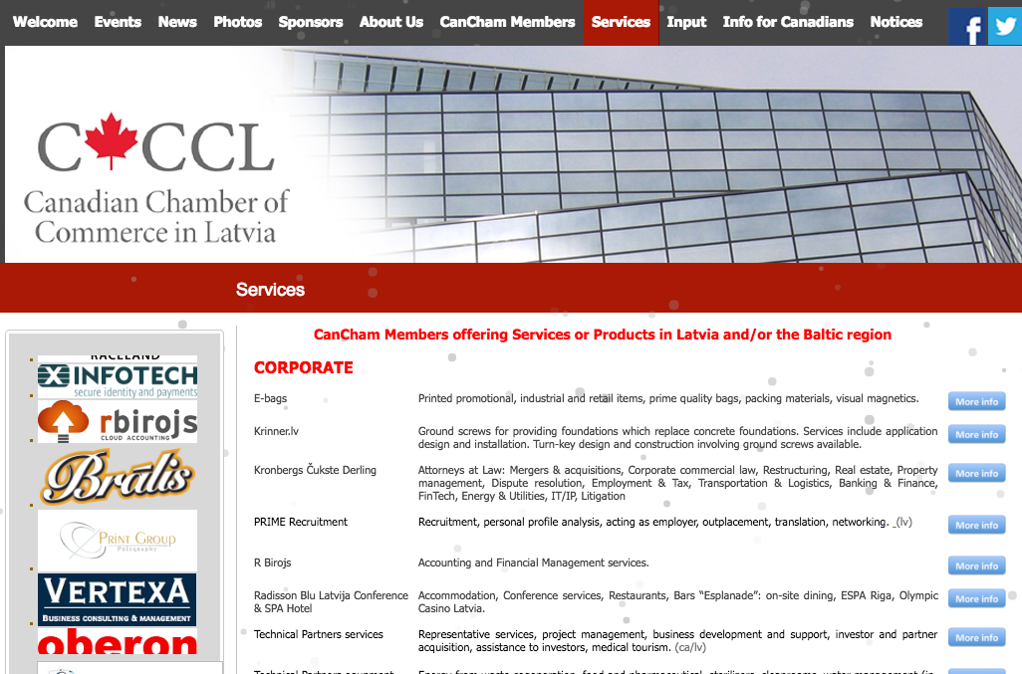

Slide 12
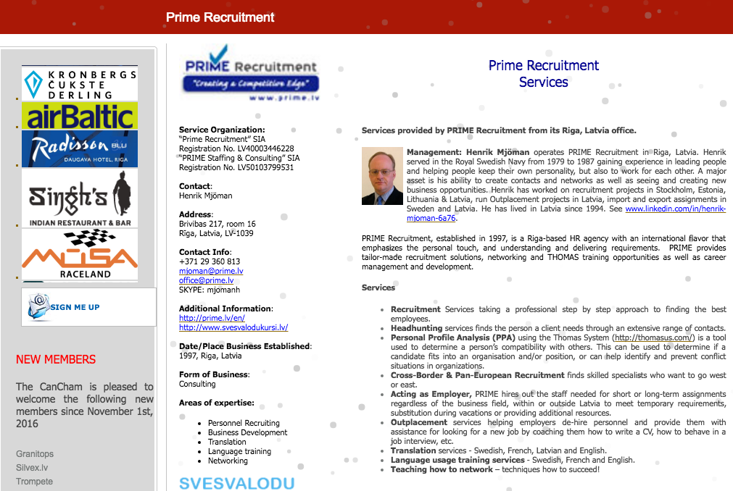

Slide 13
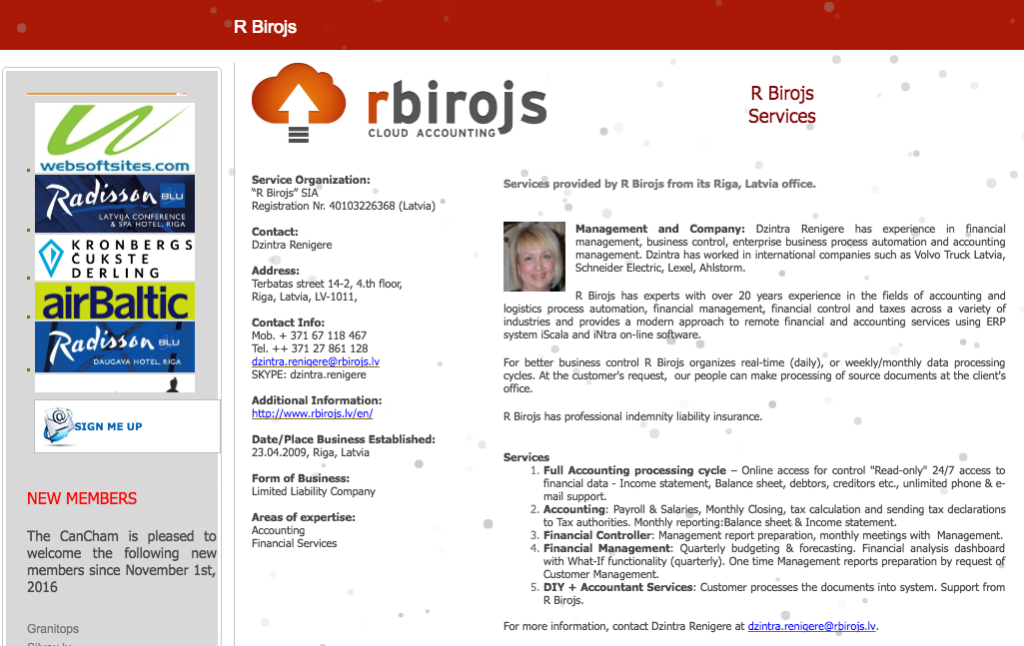

Slide 26
Networking

Slide 28
Business Opportunities

Slide 29
Thank you

