Slide 1
the Canadian Chamber of Commerce in Latvia (CanCham)

Slide 2
February 23rd, 2017
Latvia
FIRST
to ratify
CETA
The Comprehensive Economic and Trade Agreement
between Canada and the European Union

Slide 3
Introducing
H. E. Alain Hausser Canadian Ambassador to Latvia
Special Guests
Raimonds Bergmanis, Latvian Minister of Defense
Kaspars Ķikste, Defense Minister’s Legal Advisor
Edgars Tavars, Chairman of the Greens Party
Gundars Bojars, owner of Vestafume and candidate in the upcoming municipal elections.

Slide 4
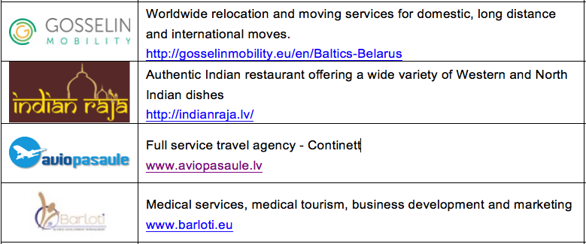
New Members

Slide 5
CETA
+
NATO
OPPORTUNITY
+
RESPONSIBILITY
=

Slide 7
CanCham
provides one stop shopping
for services in Latvia

Slide 8
The CanCham prepares to welcome the NATO deployment and
our Canadian troops
By arranging
Welcoming events
Guided tours for groups or individuals
A special introduction to the Brālis Brewery

Slide 9
Join us in Celebrating Canada
As Canada prepares to celebrate it’s 150th birthday
June 5th, Monday, 18.30
Radisson Blu Latvija Conference & Spa Hotel
With H.E. Alain Hausser, the Canadian Ambassador to Canada
and recognizing our connections to Canada
Then on
July 1st, Saturday – The CanCham celebrates Canada’s 150th birthday
at the Trompete Restaurant.

Slide 10
Raimonds Bergmanis
Latvian Minister of Defense

Slide 11
Edgars Tavars
Chairman of the Greens Party

Slide 12
Gundars Bojars
owner of Vestafume and
candidate in the upcoming municipal elections.

Slide 13
The Canadian Chamber of Commerce in Latvia
welcomes
active participants

