Slide 1

RAIL BALTICA – PROJECT OF THE CENTURY
Baiba A. Rubesa
Chairperson, Management Board
RB Rail AS
Notes:
Rail Baltic/Rail Baltica: Project of the Century for the Baltic Region
Baiba Rubesa, Chairperson, RB Rail
Business Forum of 5th Meeting of the heads of the Government of Central and Eastern European Countries and China, November 5, 2016

Slide 2

RAIL BALTICA VISION
A future driven economic corridor that closely binds
North East Europe to the rest of Europe
Notes:
Now from practical information I would like to turn THE VISION OF Rail Baltic/Rail Baltica.
George Bush Sr. Famously lost the Presidential election 1992 to Bill Clinton, when he said he does not believe in that Vision Thing.
I strongly believe that great results are attained when there is a clear vision in place.
When recruited: this was my picture from the 20th Century.
... But in a nutshell, the vision for Rail Baltica is for today’s 8 year old:
A future driven economic corridor that closely binds North East Europe to the rest of the Europe
We must clearly recognise that this project has outgrown the national scope of three Baltic countries. Economic logic obliges us to look at the Rail Baltic/ Rail Baltica project beyond the Baltic context. It is primarily a project of common European interest, which, if it is successfully implemented, will create positive synergies across the region, ranging from Finland, followed by the Baltic States, Poland and later, further west and south. It will change life in this region in a positive way for all time, providing the link now missing with the European rail network.

Slide 3
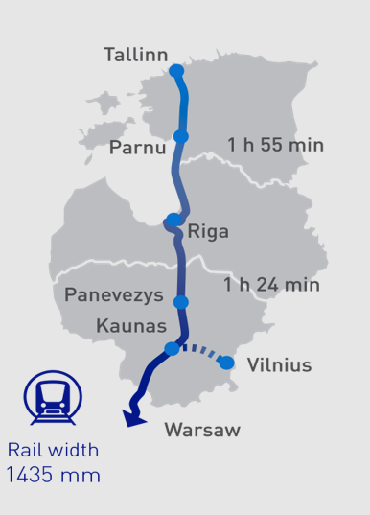
RAIL BALTICA
Baltic Project of the Century
730 km railway tracks from Tallinn to the Polish border
240 km/h speed passenger trains
120 km/h speed freight trains
10 year construction period
5 million passengers/yr
    70% regionally between Estonia, Latvia, Lithuania
16 million tons/yr cargo
    From 13 mT/yr
5 billion EURO investment over 10-15 years

Slide 4
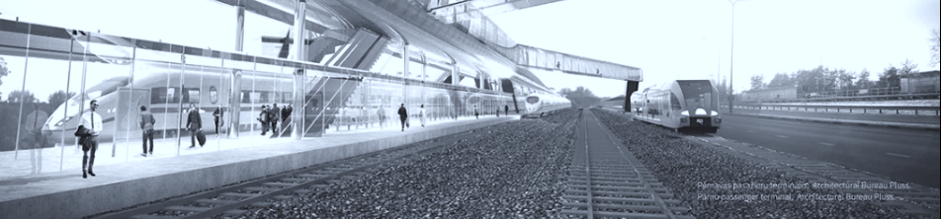
RAIL BALTICA FUTURE DELIVERY
ECONOMIC CORRIDOR
INFRUSTRUCTURE CORRIDOR
CONNECTIVITY
CAPACITY
COMPETITIVNESS
AFFORDABILITY
ENVIRONMENTAL CONSCIOUSNESS
Notes:
We must build now but look to the future. What are the needs of passengers and entrepreneurs ten, fifteen, twenty years from now?
Therefore
First -- Rail Baltic/Rail Baltica must be connected. I mean this in the broadest possible sense.
Our physical infrastructure must connect the Baltics from Kirkenes to Warsaw. It must also become a gateway from central Asia to the rest of Europe. Rail Baltic/Rail Baltica must connect the region seamlessly and remain open to new connections in the future.
Our digital infrastructure must be a seamless whole -- we need unified control, signaling and other technologies which can be efficiently managed and upgraded over time.
Our management team must span our member countries to ensure a fruitful exchange of ideas and expertise.
Our commercialization approach needs to be fully integrated with the global economy. Not limiting ourselves to EU-wide train passes. A passenger should get door ro door service - in Tallinn he should be able to buy a ticket that includes a taxi to the train station, a train to Warsaw, and a bus drive to his hotel. Our ticketing and scheduling systems should be integrated with global travel platforms, permitting side by side price and time comparisons with airline and other alternatives. Our freight management systems should enable our clients to plan traffic, calculate costs and purchase capacity at the click of a button.
A Rail Baltic/ Rail Baltica that is maximally connected -- and open to new connections -- will be equipped to serve the unpredictable needs of tomorrow's business and society.
Second -- Rail Baltic/Rail Baltica must have capacity. I mean this in terms of passengers, in terms of tonnage, and in terms of speed. Rail Baltic/Rail Baltica is a project meant to last a hundred years. We must built a railroad capable of serving tomorrow's needs, which may well prove different than we can forecast today.
Yes, we need to be fiercely cost-conscious. Yes, we must be efficient in the use of resources. But we should not accept design errors today that will inhibit our ability to serve the Baltics and Europe tomorrow. We should not accept "good enough for now" just because it is easier or politically convenient.
Third -- Rail Baltic/Rail Baltica must be environmentally conscious. In the 21st century Europe will face many challenges posed by global warming, pollution and other environmental issues. We must design a railway that strictly minimizes environmental impact -- and remain continually engaged with the environmental community.
Fourth -- Rail Baltic/Rail Baltica must be affordable. Tomorrow's Baltics will feel like a connected neighborhood only if a trip from Kaunas to Tallinn feels like a minor expense. A thousand new business opportunities will spring up only if the marginal cost per ton-kilometer of freight is far better than today. And the railway must be a profit center for our states instead of a burden to be subsidized.
To this end, we must accept only the best practices in the design and management of our project. Rail Baltic/Rail Baltica will not become an opportunity for the clever few to enrich themselves with padded budgets and cronyism. We will be cost-efficient in building the railway, and we will design a railway that can be run efficiently.
It will not be easy. No doubt there will be many who resist us out of self-interest or political expediency. But we are determined to make Rail Baltic/Rail Baltica a viable business that serves its stakeholders -- all our member states and their citizens.

Slide 5
RAIL BALTICA PROJECT BENEFITS
A powerful catalyst for sustainable economic growth in the Baltic States
A new standard of passenger and freight mobility
A new economic corridor will emerge
Sustainable employment and educational opportunities
Environmentally sustainable infrastructure
New opportunities for multimodal freight logistics development
New intermodal transport solutions for passengers
Safety and performance improvements
A new value platform for digitalization and innovation
Baltic integration in the European Union transport ecosystem - completed
Notes:
We must build now but look to the future. What are the needs of passengers and entrepreneurs ten, fifteen, twenty years from now?
Therefore
First -- Rail Baltic/Rail Baltica must be connected. I mean this in the broadest possible sense.
Our physical infrastructure must connect the Baltics from Kirkenes to Warsaw. It must also become a gateway from central Asia to the rest of Europe. Rail Baltic/Rail Baltica must connect the region seamlessly and remain open to new connections in the future.
Our digital infrastructure must be a seamless whole -- we need unified control, signaling and other technologies which can be efficiently managed and upgraded over time.
Our management team must span our member countries to ensure a fruitful exchange of ideas and expertise.
Our commercialization approach needs to be fully integrated with the global economy. Not limiting ourselves to EU-wide train passes. A passenger should get door ro door service - in Tallinn he should be able to buy a ticket that includes a taxi to the train station, a train to Warsaw, and a bus drive to his hotel. Our ticketing and scheduling systems should be integrated with global travel platforms, permitting side by side price and time comparisons with airline and other alternatives. Our freight management systems should enable our clients to plan traffic, calculate costs and purchase capacity at the click of a button.
A Rail Baltic/ Rail Baltica that is maximally connected -- and open to new connections -- will be equipped to serve the unpredictable needs of tomorrow's business and society.
Second -- Rail Baltic/Rail Baltica must have capacity. I mean this in terms of passengers, in terms of tonnage, and in terms of speed. Rail Baltic/Rail Baltica is a project meant to last a hundred years. We must built a railroad capable of serving tomorrow's needs, which may well prove different than we can forecast today.
Yes, we need to be fiercely cost-conscious. Yes, we must be efficient in the use of resources. But we should not accept design errors today that will inhibit our ability to serve the Baltics and Europe tomorrow. We should not accept "good enough for now" just because it is easier or politically convenient.
Third -- Rail Baltic/Rail Baltica must be environmentally conscious. In the 21st century Europe will face many challenges posed by global warming, pollution and other environmental issues. We must design a railway that strictly minimizes environmental impact -- and remain continually engaged with the environmental community.
Fourth -- Rail Baltic/Rail Baltica must be affordable. Tomorrow's Baltics will feel like a connected neighborhood only if a trip from Kaunas to Tallinn feels like a minor expense. A thousand new business opportunities will spring up only if the marginal cost per ton-kilometer of freight is far better than today. And the railway must be a profit center for our states instead of a burden to be subsidized.
To this end, we must accept only the best practices in the design and management of our project. Rail Baltic/Rail Baltica will not become an opportunity for the clever few to enrich themselves with padded budgets and cronyism. We will be cost-efficient in building the railway, and we will design a railway that can be run efficiently.
It will not be easy. No doubt there will be many who resist us out of self-interest or political expediency. But we are determined to make Rail Baltic/Rail Baltica a viable business that serves its stakeholders -- all our member states and their citizens.

Slide 6
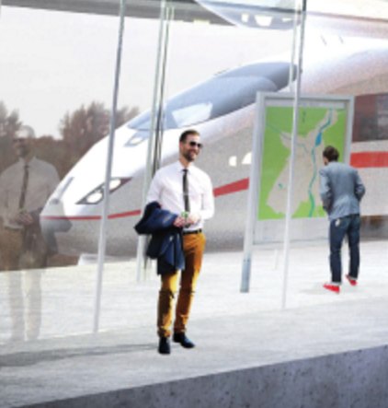
RAIL BALTICA CENTRAL PROJECT MANAGMENT
The role of the joint venture RB RAIL AS
Represents the project and ensures interoperability overall;
Represents all the shareholders’ interests;
Ensures cost savings generated by economies of scale;
Guarantees successful project implementation, unrestricted functioning of the single market and equal access to infrastructure;
Develops a Centre of Competence
Notes:
Finally, let me conclude my remarks by elaborating a little on the why there is value in having a single implementing body – in this case the joint venture RB Rail – for such a project.
Since the benefits and risks of Rail Baltica extend beyond the borders of a single country, a single body representing the overall project that also ensures interoperability is key.
The joint venture represents all the shareholders’ interests, not the national ones of a particular country.
By consolidating import purchases, the joint venture will ensure cost savings generated by economies of scale, and reduce if not prevent unproductive competition between the Baltic States. Furthermore, it should ensure a transparent framework for minimizing the risks inherent in such procurement (including corruption and mismanagement risks).
By executing unified procurement for the project, financial flows, project planning, etc., the successful progress of the project can be guaranteed, as can the transparency of processes, infrastructure interoperability between the different countries, as well as the unrestricted functioning of the single market and equal access to the infrastructure for its future users.
Finally, the joint venture will swiftly become a centre of competence fostering and accumulating knowledge and expertise for the benefit of the overall project, with the potential to export this expertise in the future to similar cross-border projects, both in the European Union and beyond its borders.
Ladies and gentlemen, if nothing else, I hope that from my introductory remarks you are able to take away the fact that the devil is in the detail for this project. Alignment, collaboration, efficience and economies of scale are important to deliver.
With Rail Baltic/Rail Baltica we have the opportunity to deliver a very unique project in a very unique manner.
Precedent setting for the region and precedent setting for the European Union.
And with that, let me give the word to my colleague in Estonia, Indrek Orav.

Slide 7
RAIL BALTICA PROJECT GOVERNANCE STRUCTURE
Estonia – Ministry of Economic Affairs and Communication
Latvia – Ministry of Transportation
Lithuania – Ministry of Transportation and Communication
BENEFICIARIES: THREE MINISTRIES
Rail Baltic Estonia OU
Eiropas Dzelzceļa līnijas
Lietuvos Geležinkeliai
RB RAIL SHAREHOLDERS
Rail Baltica Statyba
RB Rail
(Branches in LT, EST)
CENTRAL PROJECT COORDINATOR
Estonia
Latvia
Lithuania
NATIONAL IMPLEMENTING BODIES
Rail Baltic Estonia OU
Eiropas Dzelzceļa līnijas
Lietuvos Geležinkeliai
Estonian Technical Regulatory Authority
Rail Baltica Statyba
Notes:
Before we specifically turn to the Contracting Scheme, let me explain the roles of the project’s many actors in project implementation.
First, the owners of the infrastructure to be built are the three Baltic countries – Estonia, Latvia and Lithuania.
Thus we talk about beneficiaries – the three respective ministries of Estonia, Latvia and Lithuania. At the same time, for the Ministries to be indirect shareholders of the joint venture RB Rail, special purpose vehicles were created in each country to act as the direct Shareholders in RB Rail.
The Joint Venture, RB Rail, is the main coordinator of the project, responsible for the railway’s planning, design, construction and marketing (including branding). As I mentioned, it is a commercial company registered in Latvia.
In order to ensure VAT remains in Lithuania and Estonia for work that will be done there, as well as to address the needs of Estonian and Lithuanian employees, RB Rail will establish branches in both capitals.
Rail Baltic Estonia, the Estonian Technical Regulatory Authority, Eiropas Dzelzceļa līnijas, Lietuvas Geležinkeliai, Rail Baltica Statyba – are National implementing bodies that are responsible for implementing the project in their respective countries.
At the same time as you can see, all but the Estonian Technical Regulatory Authority are also the Joint Venture’s direct shareholders
And now to the key topic: what is in the Contracting Scheme agreement?

Slide 8
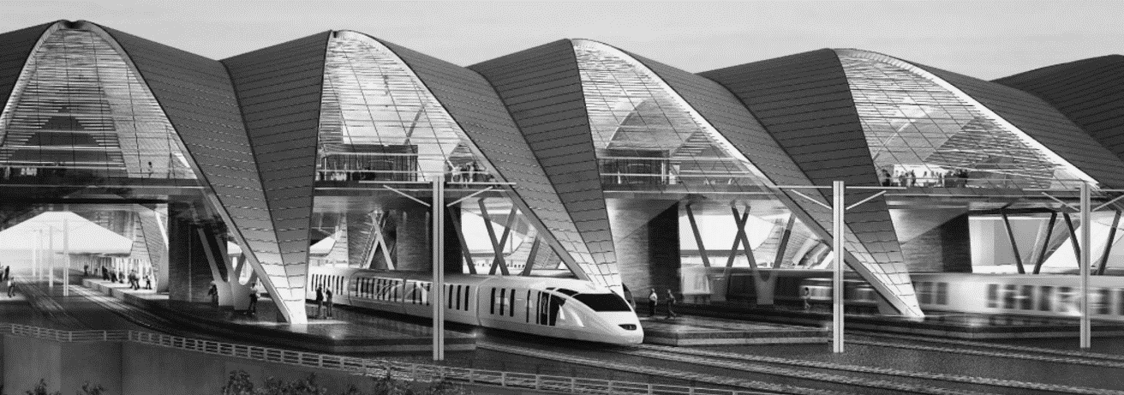
GLOBAL PROJECT TIME LINE: Baltic States
Rail Baltica Contracting
Scheme Agreement signed
EU CEF2 Grant
Agreement signed
JV RB Rail AS
established
Construction completed
in Baltic States
Technical Design
2015
2017
2020
2030
2014
2016
2018
2025
EU CEF 1 Grant
Agreement signed
Key studies
Completed
Land acquisition
completed
North Sea – Baltic
TEN-T Core Network Corridor
completed*
Intergovernmental Agreement signed
* Regulations (EU) No 1315/2013 and No 1316/2013

Slide 9
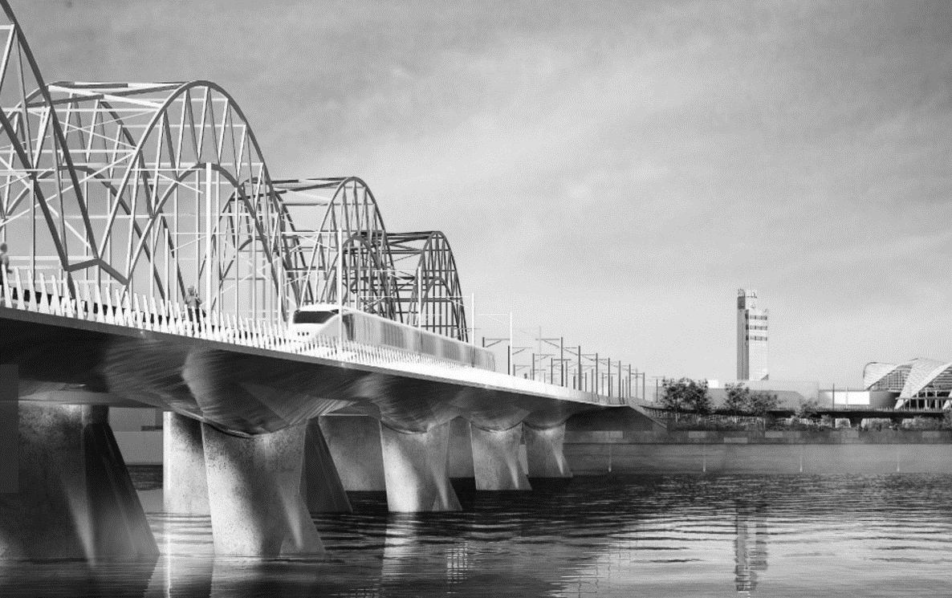
RAIL BALTICA ROUTE ALIGNMENT APPROVAL
J
ESTONIA
LATVIA
LITHUANIA
VILNIUS
TALLINN
PÄRNU
EE/LV
BORDER
RIGA
CENTRAL
RIGA AIRPORT
LV/LT
BORDER
PANEVĖŽYS
KAUNAS
LT/PL
BORDER
APPROVED SECTION
IN THE PROCESS OF APPROVAL
SUBJECT TO RESULTS OF THE UPGRADE FEASIBILITY STUDY
IN PLANNING PROCESS

Slide 10
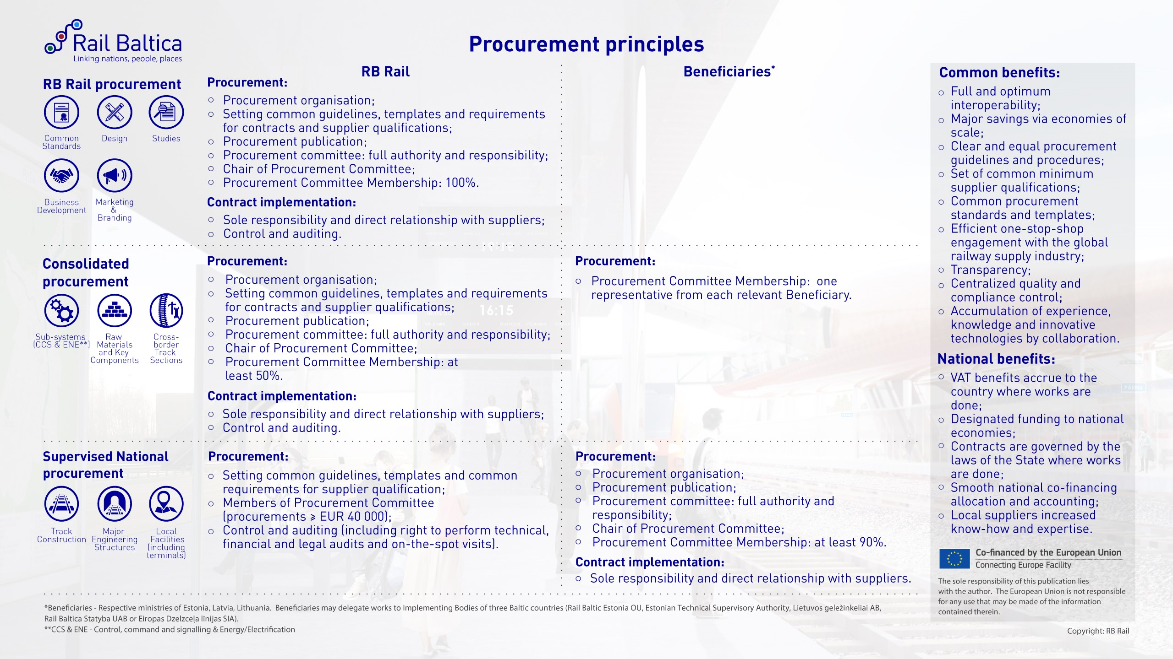

Slide 11
RAIL BALTICA PROCUREMENT PLAN
Procurement phase
Studies
Implementation phase
Design
Railway Line Construction & Supplies
Stations / Terminals / Maintenance Facilities Construction
ERTMS
Electrification
2015 2016 2017 2018 2019 2020 2021 2022 2023 2024 2025 2026
TESTING

Slide 12



NATIONAL PROGRESS OF RAIL BALTICA IN 2016
ESTONIA
LATVIA
LITHUANIA
SEIA/EIA & county planning in final stage; Decision plan Q2 2017
Preliminary design for the railway line completed in the Southern part of Estonia, full completion is expected in Q1 2018
EIA & spatial planning completed and status of national interest object approved
Preliminary design for the railway line completed.
International sketch design competition completed for the central multi-modal public transport hub in Riga and the Rail Baltica railway bridge
EIA & spatial planning for section Kaunas – LT/LV border approved in January 2017

Slide 13
OUTSTANDING ISSUES IN 2017
ESTONIA
LATVIA
LITHUANIA
SEIA/EIA & county planning completed
Preliminary design for the railway line completed in the Central part of Estonia, full completion is expected in Q1 2018
Construction of tramline link from RB Ülemiste passanger terminal to Tallinn TEN-T Airport finished
Land acquisition process starts
Procurements on detailed designing of the Central section of route in Latvia at advanced stage
Procurement on detailed technical design for Riga International Airport Rail Baltica station finished
Procurement on Design&Build for Riga Central Railway station finished
Land aquisition process starts for the Central section
Upgrade feasibility study for section “PL/LT state border - Kaunas RRT Palemonas” to be completed
Procurement start on preparation of the Spatial plan for straightening and speed increase of section “PL/LT state border - Kaunas RRT Palemonas” railway line
Land acquisition process starts for section Kaunas RRT Palemonas - LT/LV state border

Slide 14

PROJECT FINANCING
National & EU Contribution
TOTAL ESTIMATED CONSTRUCTION COSTS – 5 BILLION €
2025
FINANCIAL CONTRIBUTION: 765 MILLION EUROS
(of which CEF Grants ≈ 633 MILLION EUROS; up to 85% from total eligible costs)
2020

Slide 15

PALDIES! THANK YOU! AITÄH!
AČIŪ! KIITOS! DANKE!
MERCI! DZIĘKUJĘ!

Slide 16
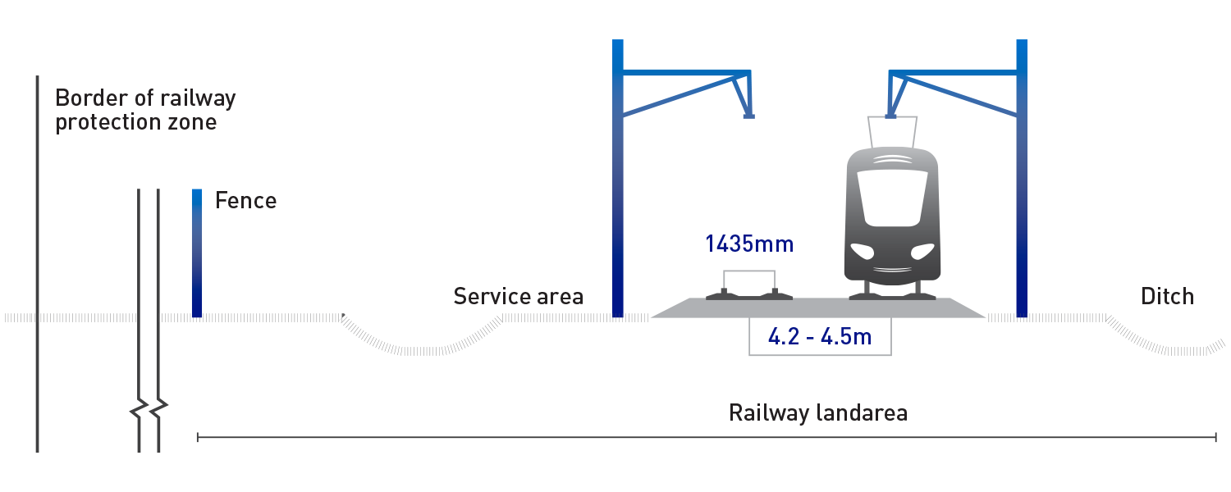
RAIL BALTICA
Global Project definition / Main technical parameters
1435 mm Standard gauge
2 Tracks
240 km/h speed passenger trains
120 m/h speed freight trains
22.5 t Axle load
2x25 kV AC Double track electrified
740 m Minimal length of freight train
All crossings with roads at two levels
Fenced
Environment protection (Animal streaming systems, Noise barriers)

Slide 17
Global approach towards delivering Rail Baltica
Process diagramm:
Approach to implementation
Phase
Exceptions to Approach
TIME
CONCEPT AND CORRIDOR
JOINT
NO EXCEPTIONS
ALIGNMENT AND APPROVALS
NATIONAL
NO EXCEPTIONS
DESIGN e.g. Consolidated Preliminary Design
RB Rail
Design & Build for «local facilities»
CONSTRUCTION
NATIONAL
Component supplies, electrification, CCS/ERTMS, cross-border sections, NoBo
INFRASTRUCTURE MANAGEMENT
JOINT
To study, define and agree by IM study

Slide 18

RAIL BALTICA Design and Construction Process
For the railway:
Contracted by national IB’s
Three parallel national processes
RBR in-house + external experts
Contracted by RBR: design contract
Contracted by national IB’s or RBR; division in parts according to CS
preliminary design
consolidated preliminary design
master design
detailed technical design
construction
For the local facility:
Contracted by national IB: design and build
(except for ERTMS and electrification parts)
NB! Responsibility for master design lies with RBR
master design
detailed technical design
construction
RBR
- external approval or decision

