Slide 1
the Canadian Chamber of Commerce in Latvia Work Groups

Slide 6
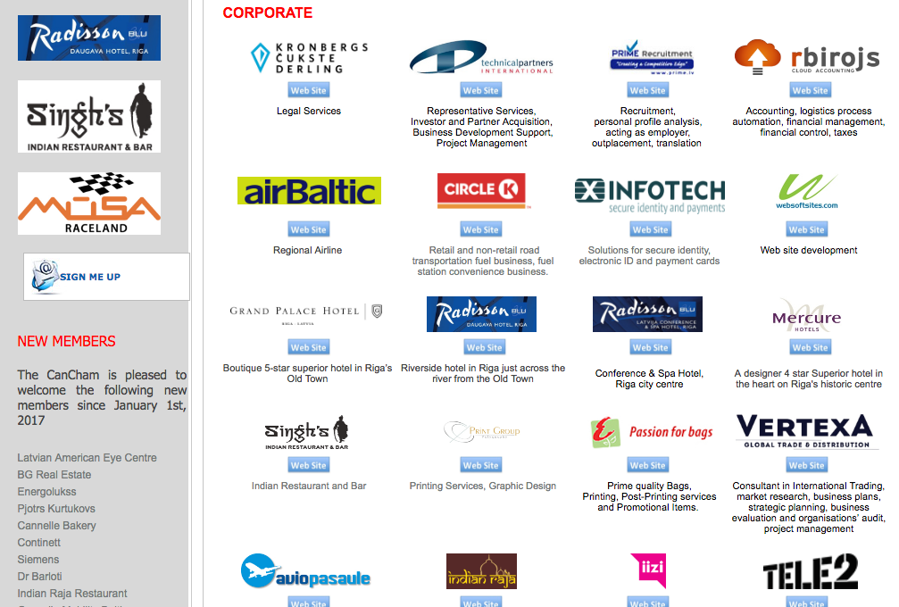

Slide 7
The Canadian Chamber of Commerce in Latvia
welcomes
active participants

