Slide 1


the
Canadian Chamber of Commerce in Latvia
(CanCham)
Canada in Latvia

Slide 2
Latvians and Canadians from Canada

Slide 3

Valters Kronbergs

Slide 4
Pēteris Brauns

Slide 5
Pēteris Ruģelis and Elmārs Tannis

Slide 6

Harijs Ozols

Slide 7
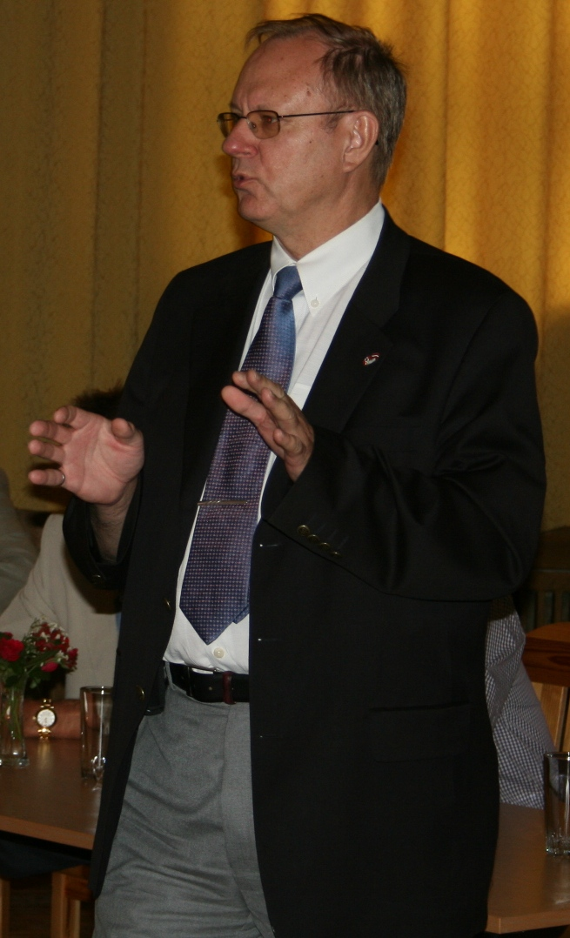











Ed Kalvins
a Canadian company, established in 1992 focused on
Latvia and Northern Europe
bringing Canadian products and expertise to Latvia
specializing in project management, monitoring consultancy and representative services,
and representing
Technical Partners International Inc. CANADA • LATVIA • SAUDI ARABIA • TURKEY • UKRAINE • UNITED KINGDOM

Slide 8

Tālis Kivlenieks
Father....Antons Kivlenieks (1924-1964), born in Kalupe, Latvia
1945 Emigrated to Canada as a DP
1957 Founded Kalupe Jewellery Ltd. Toronto
Son.....Talis ....Born 1956, Toronto
Moved to Latvia ..June 2008.
www.kalupesrotas.lv

Slide 9


ABENS KONSULTANTS

Slide 10

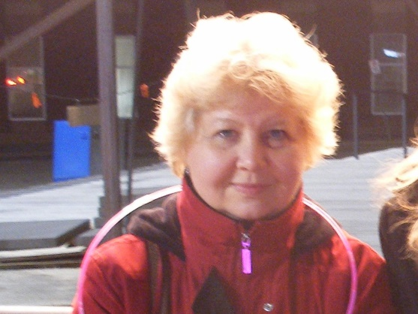


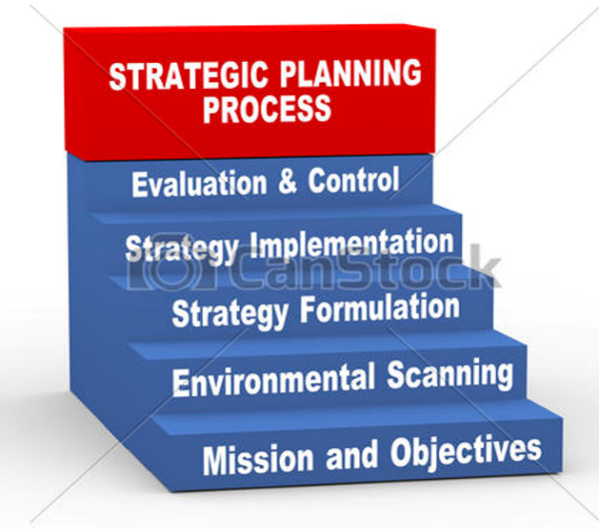

Inta Consulting

Slide 11

Valdis Liepiņš

Slide 12
A Canadian Influence

Slide 13

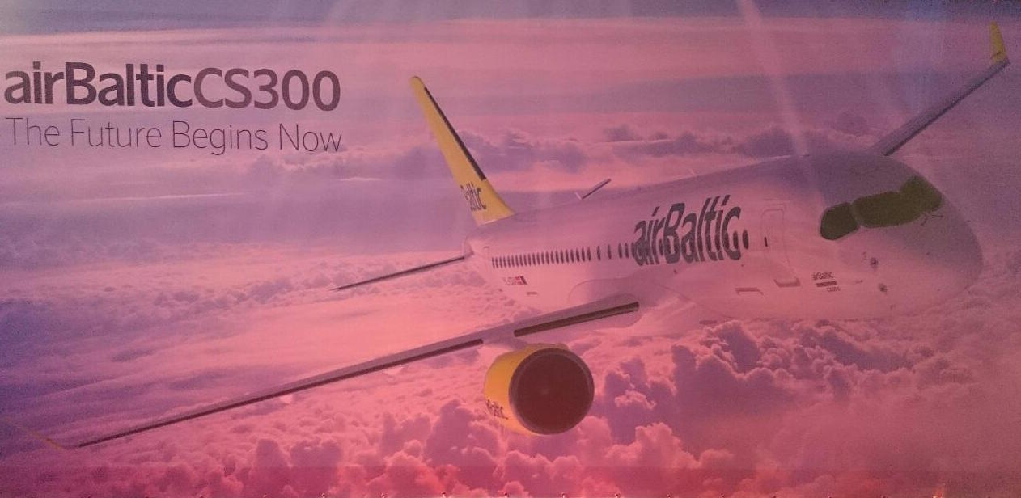
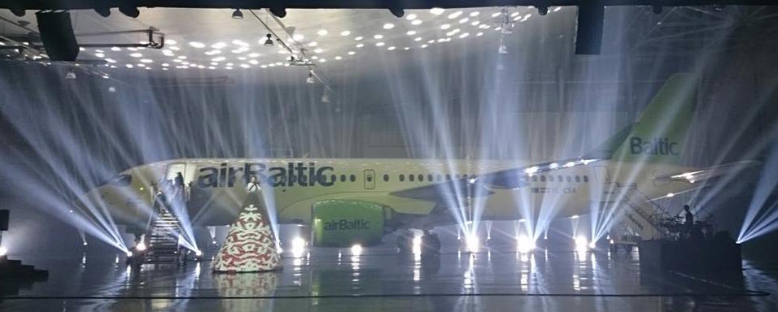

Slide 14


Slide 15
Canadian Ownership

Slide 16

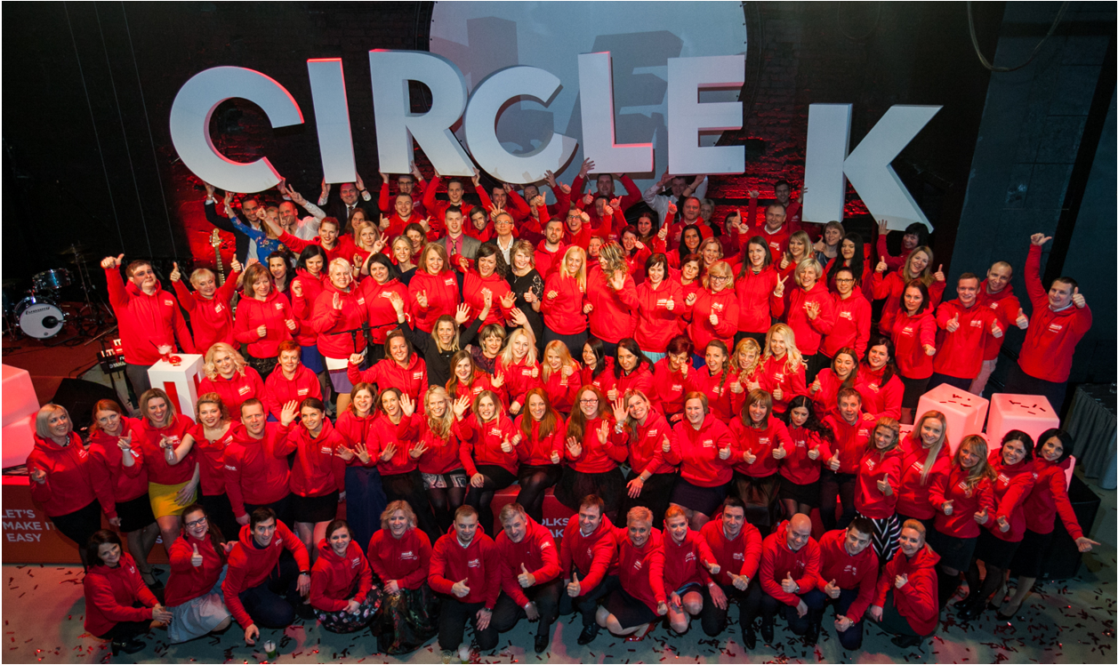


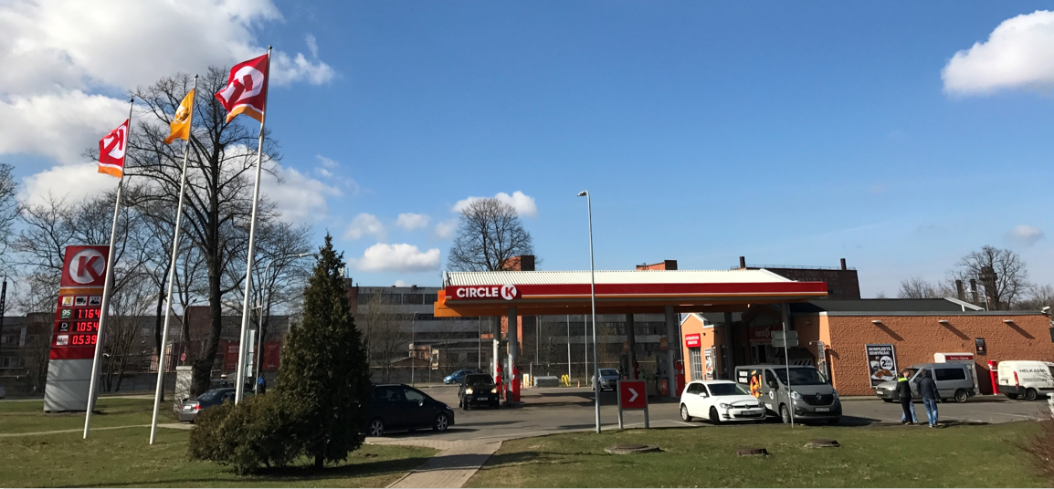

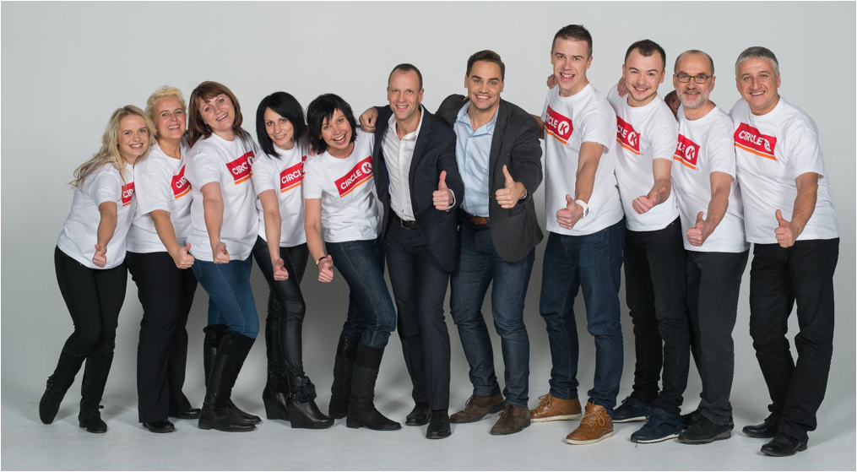
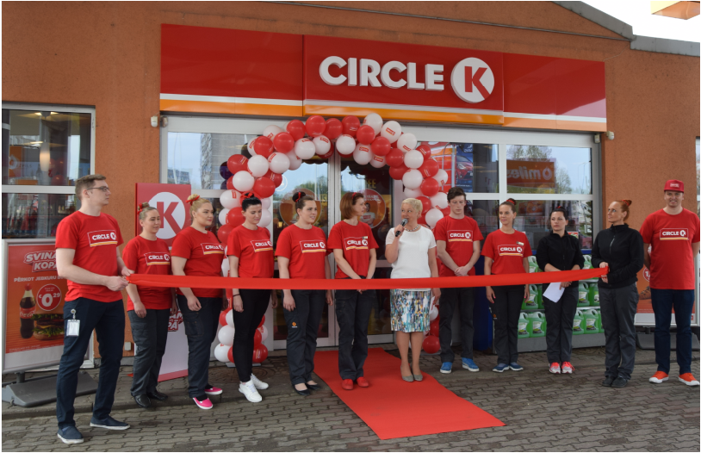
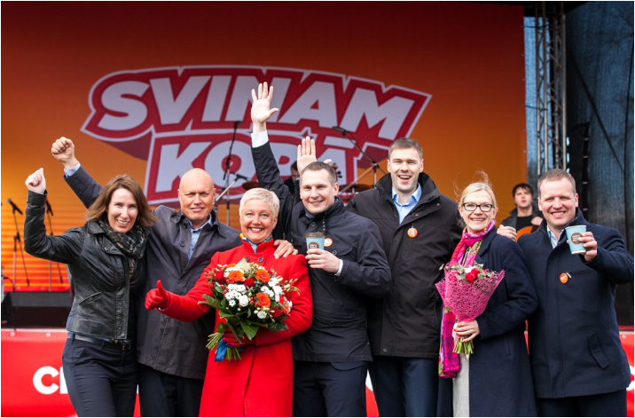
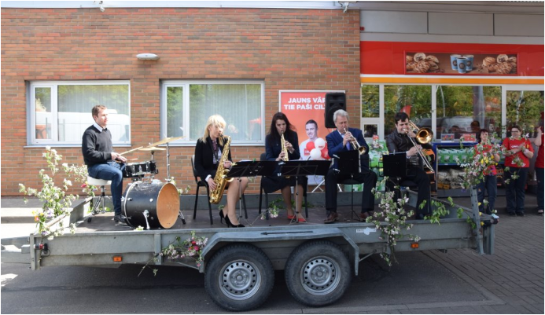

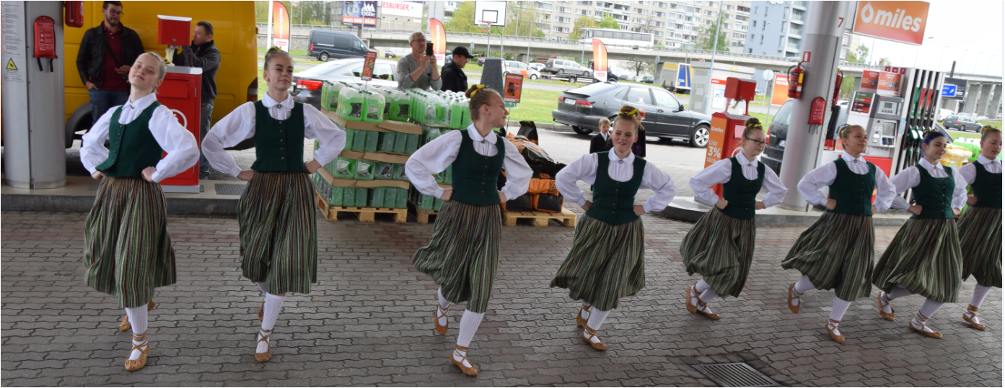
RE-branding

Slide 17
Working with Canadians

Slide 18



Moving | Relocation | Move management | Immigration | Consultancy
Every move you make
www.gosselinmobility.eu

Slide 19
Latvians and Canadian from Canada
Baiba Rubesa, Rail Baltica
Daniels Liepiņš, Trompete
Eriks Seminovs, CanCham
Guntis Brumelis, LU
Harolds Bulmanis, Sun Crisp
Harry and Ruta Whittaker, Ekosaule
Imants and Vaira Freibergs
Ivonna Bradley
Karl Sarkans, Geneva Capital
Klavs Zichmanis
Larry Chilton
Margita Gailitis
Māris Ozols
Martins Ritins, Vincents
Pauls Calitis, Air Baltic
Pauls Miklasevics, Baltikums Bank
Peteris Apse, Adenta
Uldis Hodgins

Slide 20
A Canadian Influence
Ainars Jekabsons, Ozollapas
Ainis Caunans, Apdares Studija
Aldis Pauga, Baltijas Helikopters
Andrea Balazsova, Bell Helicopter
Eduard Bondarenko and Mark Katz, Belam Riga
Gundars Bojars, VestaFume TLG
Robert Dewar, Bombardier
Romualds Gertāns, Rommila
Sam Davidovich, Transcontinental Consulting Company Ltd

Slide 21
Canadian Ownership
Jamie Torpey, Venturecorp Property Holdings Limited
Raivis Alksnis, Krown Factory

Slide 22
Working with Canadians
Adrians Ļaudansks, SOL Latvia

