Slide 1





CanCham Christmas supporting
“Nāc līdzās!”

Slide 2


Slide 3

Groups
Business Support
Construction Related Services
Consultants
Development Projects
Export
Healthcare / Medical Services / Medical Tourism
Information Technology

Slide 4
Groups
Language Services / Education
Logistics
Promotion and Advertising
Market Entry and Development Services
Sales Organizations or Representatives
Travel - Business and Tourism
Embassies and Organizations
Companies / Organizations located in Canada

Slide 5


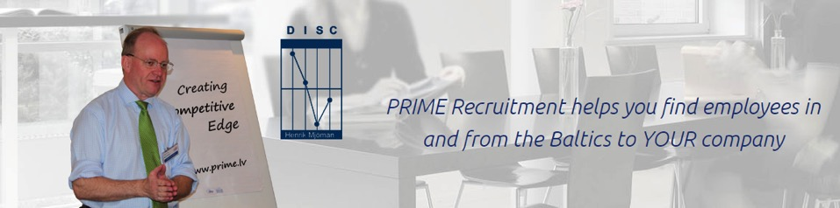

Slide 6


Slide 7

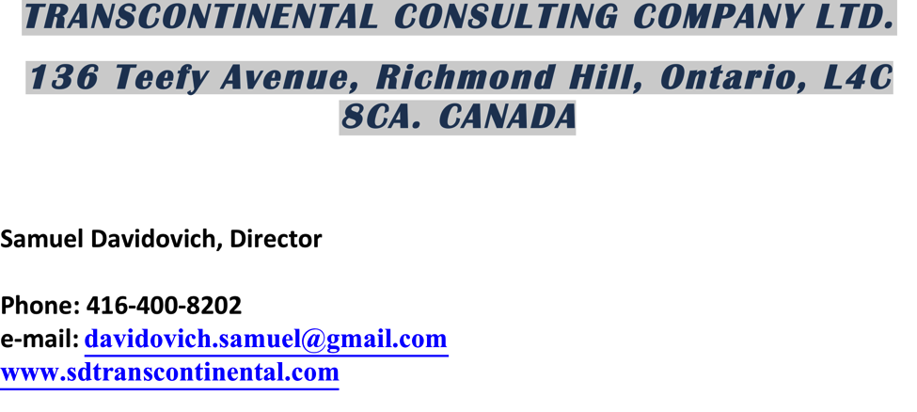

Slide 8


Slide 9


Slide 10

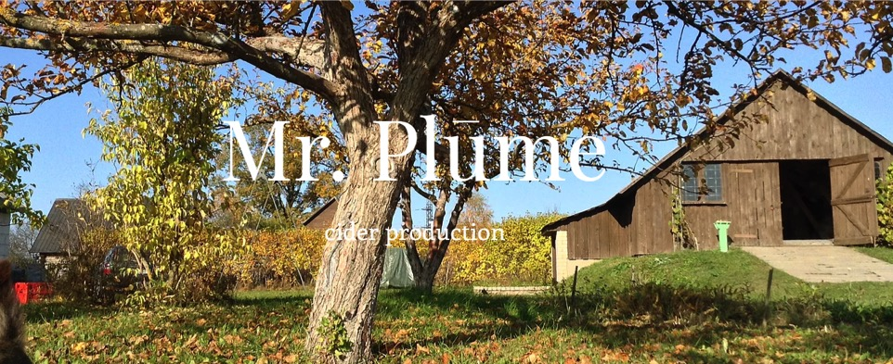

Slide 11
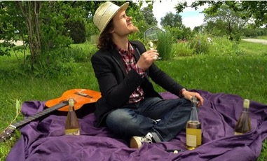

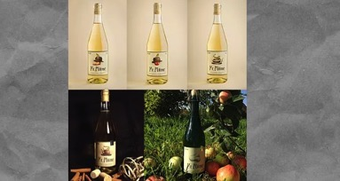
We offer
Tours - visit our farm, get to know our story, taste our products, purchase at site.
​
Drinks - we offer different ciders, fruit wines, strong spirits.
​
Music can be performed in addition. Acoustic, bluesy, jazzy, instrumental by cider producer
​
We can do tastings supplemented with stories and live music at Your location.

Slide 12


Slide 13


Slide 14

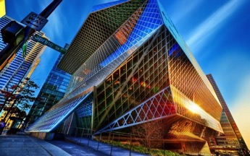
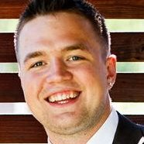
ARCHITECTURAL ENGINEERING
ELECTRICAL ENGINEERING
ENVIRONMENTAL ENGINEERING
GEOMATICS ENGINEERING
MECHANICAL ENGINEERING
STRUCTURAL ENGINEERING
TRANSPORTATION ENGINEERING
http://www.volkoengineering.com/en/architectural-engineering/

Slide 15
BG Real estate
Company established in 2005
Owns buildings and commercial premises in several cities of Latvia – Bauska, Daugavpils, Tukums, Valmiera, Valka and Ventspils.
Ventspils, Kuldigas 15 – architectural building built in 1910 and completely renovated in 2015.
Best offer in town! One last apartment (out of six) for long term rent available! 77m2, two bedrooms and living room equipped with kitchen furniture, etc.
More info on Facebook: Ventspils, Kuldigas 15.

Slide 16
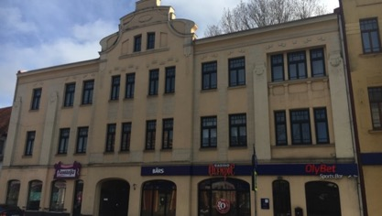
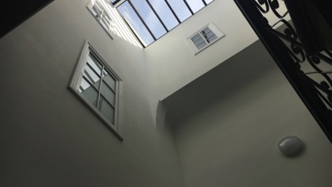
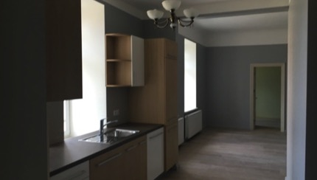
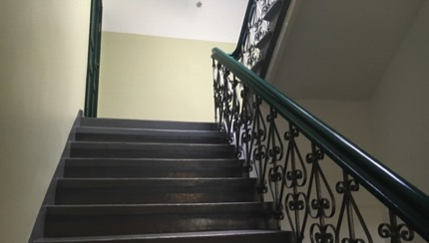
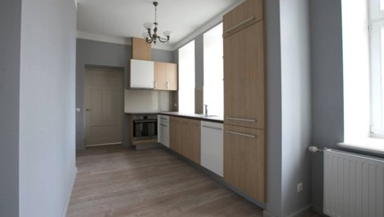
Photos of
VENTSPILS, KULDIGAS 15

Slide 17
Optibet Sports Bars
Optibet is leading I-Gaming operator in Latvia. Established 1999. Offering land based sports betting and since 2008 also online betting. Launched online casino games in 2012. Part of Lifland Gaming Group owned by Nordic Leisure AB (Publ). Look into www.optibet.lv
Optibet owns retail chain of 6 “Optibet Sports Bars”. Info at www.sportabars.lv
Flagship operations with cuisine in Riga, Kr.Barona 108 and Jurmala, Jomas street 61
Optibet - long time partner and tenant for BG Real Estate
Optibet Sports Bar is one of main sponsors and supporters for the best Latvian beach volleyball team Samoilovs/Šmēdiņš, Ranked Nr.1 in World rankings for three times and also this year 2016!
Prior Olympic games in Brazil there was a brand SAM/SME Road to Rio established in cooperation with Optibet

Slide 18

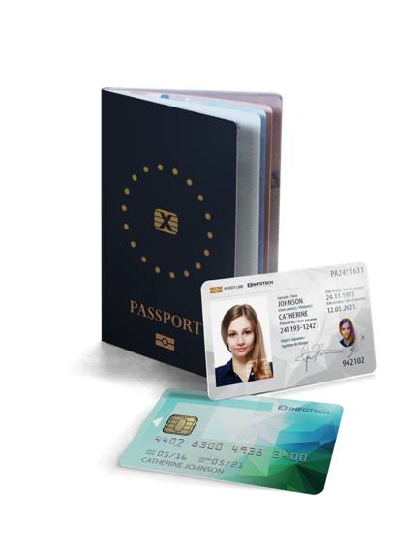
www.x-infotech.com
WHO WE ARE
We provide software solutions for digital identity documents and smart cards:
  Electronic passports
  National ID cards
  Residence permits
  Driver Licenses
  Healthcare cards
  Payment cards
OUR CUSTOMERS
Governments, border control, banks.
OUR GEOGRAPHY
Global market – Europe, Africa, Latin America, Asia.

Slide 19
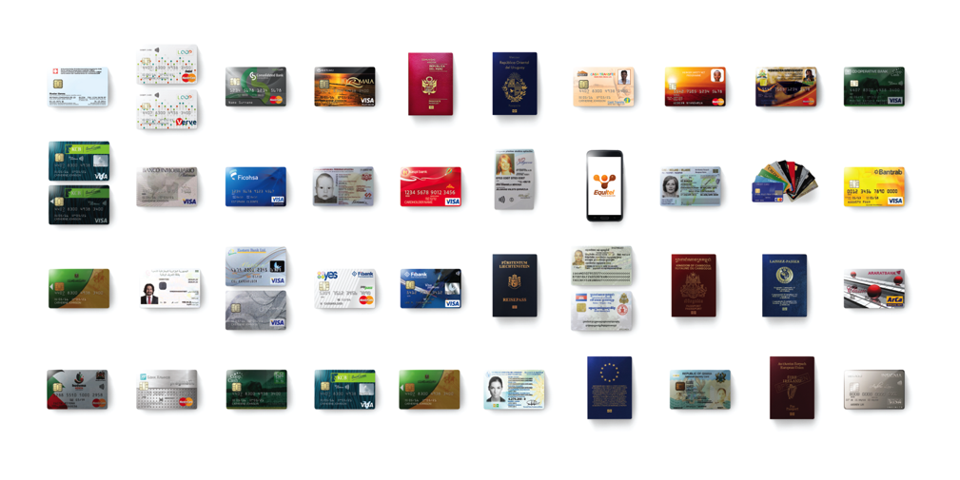
PROJECTS WORLDWIDE

Slide 20

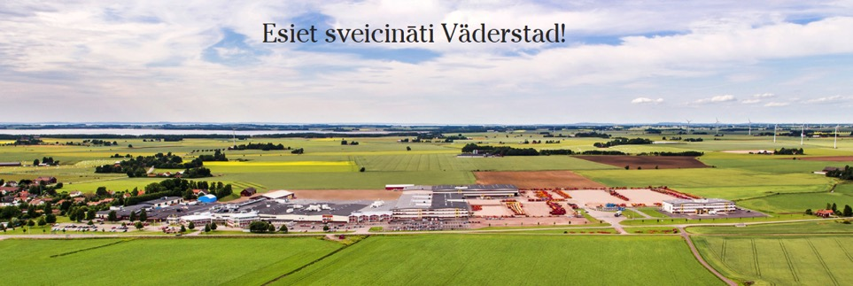
Mēs esam zviedru ģimenes uzņēmums, kas ražo lauksaimniecības tehniku, kas tiek pārdota visā pasaulē. Rūpnīca atrodas mazā Zviedrijas pilsētiņā Väderstad. Mūsu panākumu atslēga ir mūsu degsme un zināšanas veidojot modernu un inovatīvu lauksaimniecības tehniku. Šeit sākas lauksaimniecība.

Slide 21
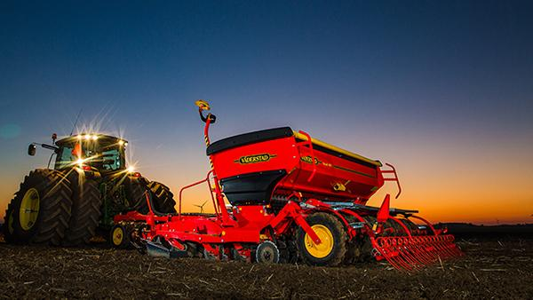
SIA Väderstad ir Zviedrijas kompānijas Väderstad-Verken AB meitas uzņēmums, kas Latvijā ar sekmīgiem rezultātiem darbojas jau no 2002. gada.

Slide 22


LatviaDental Clinic
8 Antonijas street
You will get a beautiful smile
You will keep your teeth
healthy for a lifetime
You will receive a holistic
approach to your health
You will look and feel
younger and more vibrant
You will become proud
and confident in your smile!

Slide 23

KIDS Dental IQ
An innovative program for children to:
establish a dental culture
remove fear of “dental chair”
learn how to properly take care of teeth
have unforgettable fun in process
“We believe, if done properly, people can keep their teeth for 100 years.”
- Dr Natalia Orlova, Director at LatviaDental, Founder of “KIDS Dental IQ” and International Dental Aesthetic School

Slide 24


Slide 25

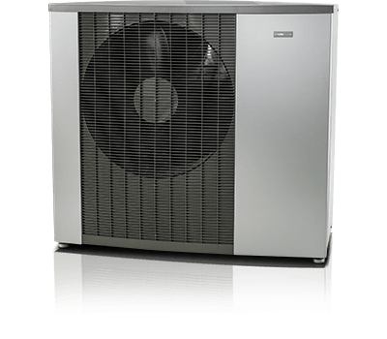
NIBE F2120

Slide 26
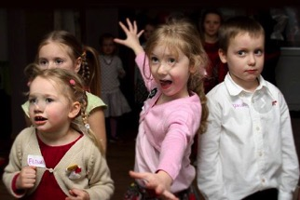
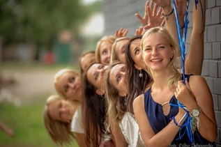

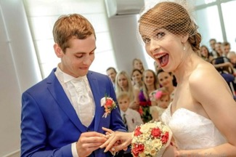

Photography of events,
photo sessions,
weddings

Slide 27
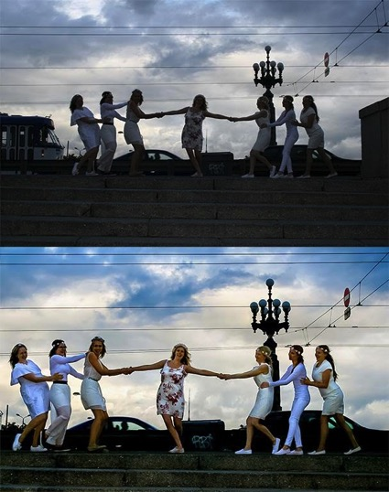
Corrections to pictures that didn’t turn out right - dark / light.
JPG, RAW, PING TIFF, DNG files processing.
Correcting old photo paper photos - digitizing.
Working on various photo programs.

Slide 28


Slide 29


Slide 30

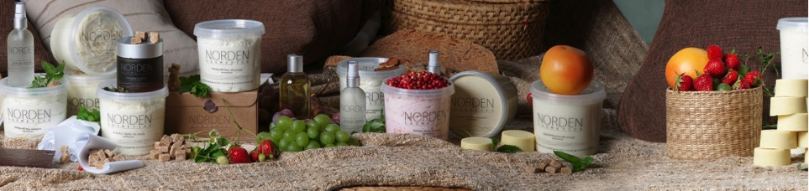
Norden cosmetics was established in 2012.
Owners - Inese and Andris Priekuļi.

Slide 31

Norden cosmetics products are used in SPA centres, by body treatment professionals as well as physiotherapists.
Sugar waxing products can be used both by professionals and at home.

Slide 32
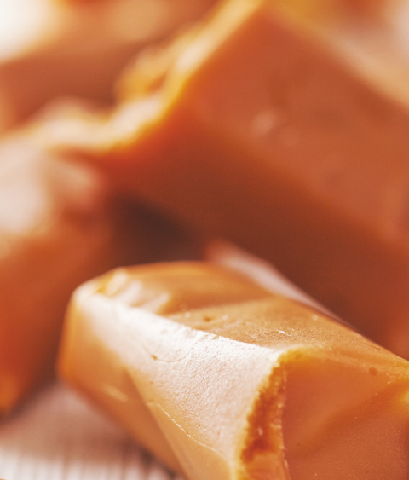

SIA SKRĪVERU SALDUMI
ĢIMENES UZŅĒMUMS
DIBINĀTS 2005. GADĀ SKRĪVEROS;
RAŽOTNES:
PIENA KONFEKŠU “GOTIŅA”
RAŽOTNE LIZUMĀ;
SALDUMU RAŽOTNE SKRĪVEROS;

Slide 33
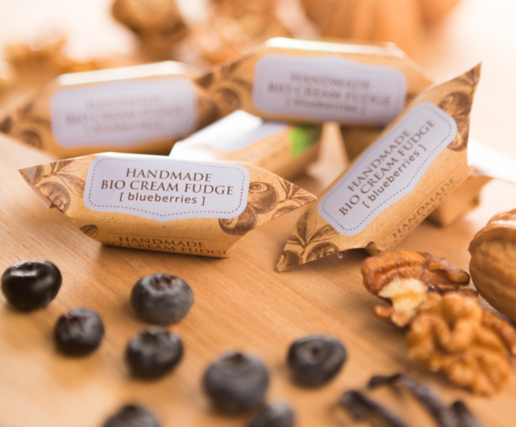
MISIJA
APVIENOT VESELĪGO AR SALDO!
VĪZIJA
RADĪT MŪSDIENĪGUS, VESELĪGUS UN VĒRTĪGUS SALDUMUS
MISIJA UN VĪZIJA

Slide 34
Normunds Medens

Slide 35


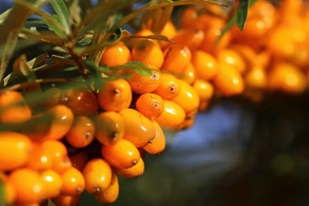
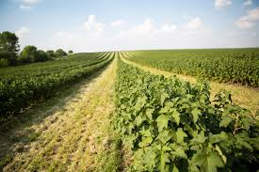
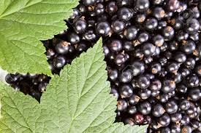
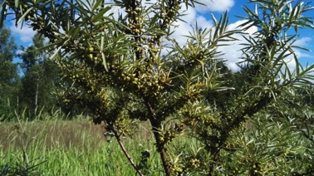
Organic farming

Slide 36
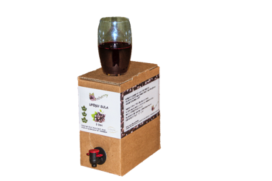
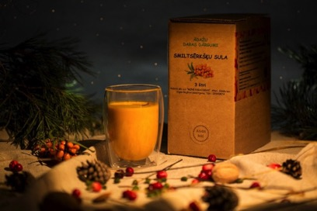
Our products now
Black currant juice
Sea buckthorn juice

Slide 37

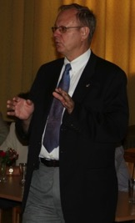











Ed Kalvins
a Canadian company, established in 1992 focused on
Latvia and Northern Europe
bringing Canadian products and expertise to Latvia
specializing in project management, monitoring consultancy and representative services,
and representing
Technical Partners International Inc. CANADA • LATVIA • SAUDI ARABIA • TURKEY • UKRAINE • UNITED KINGDOM

Slide 38
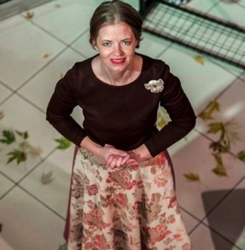


Slide 39
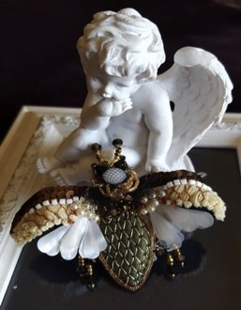

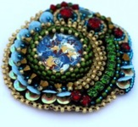
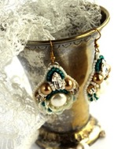
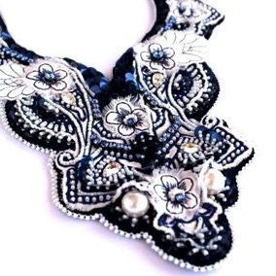
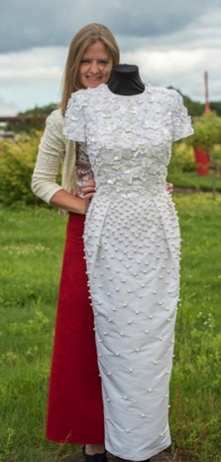

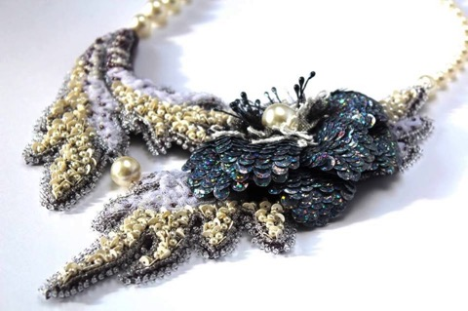
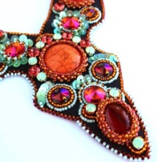
...MINIBAGS...
...MAKING...
...BROOCHES... EARRINGS...
...EMBROIDERED DRESSES...
...NECKLACES...

Slide 40

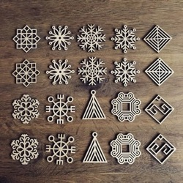
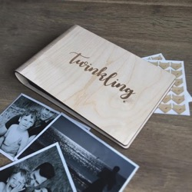
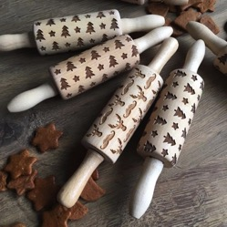
VAGA concept is to create and implement ideas. From idea to product, taking care of quality, simplicity, creativity, materials, design, joy and happiness.

Slide 41


Slide 42


Slide 43
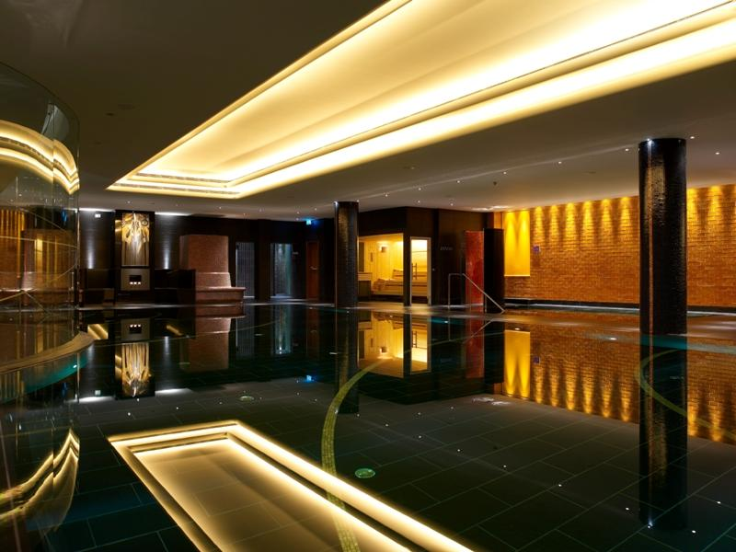


Slide 44
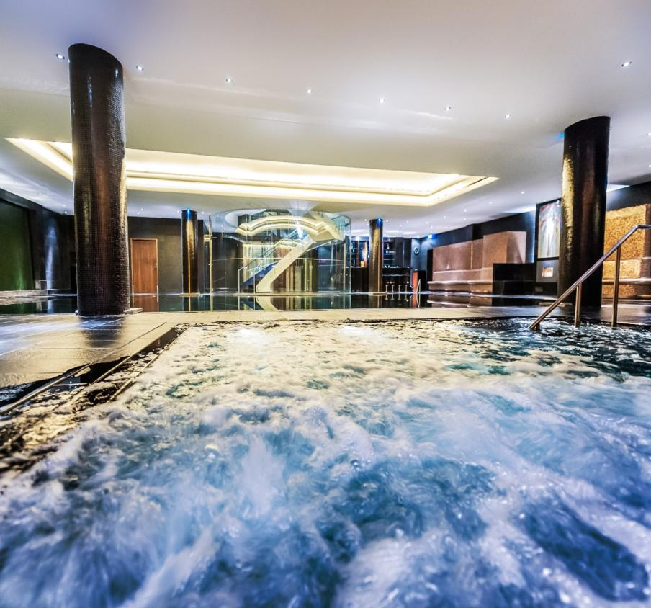

Slide 45
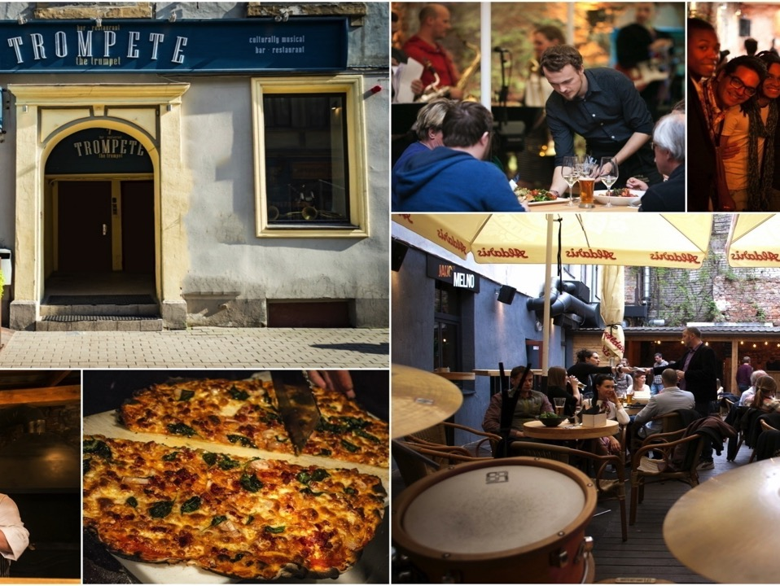

Slide 46
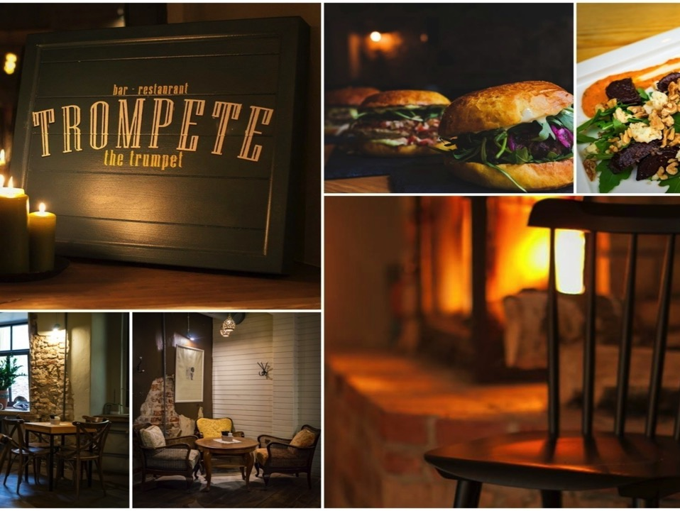

Slide 47

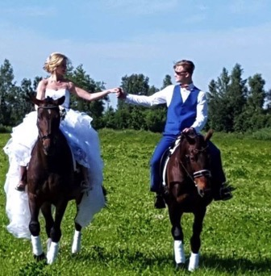
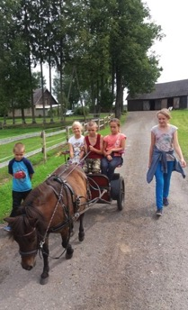
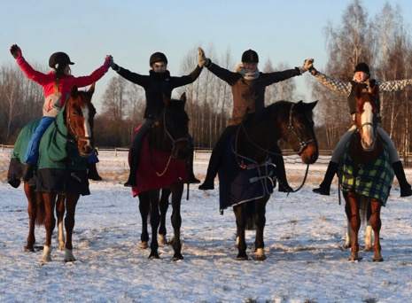
Camps for children
Wedding escort
Horse riding training

Slide 48
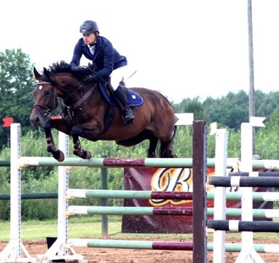


Horse riding competitions
«Drostalu kauss»

Slide 49



SK Drostalas thanks For sponsorship
«Drostalu kauss 2017» Cancham and members:
Radisson Blu Latvija Conference & SPA Hotel
Restaurant Trompete
Brewery «Brālis»
Kindly invited to support us at «Drostalu kauss 2018»!

Slide 50



Farm «Medīgas»
Growing of seedlings and flowers
«Medīgas» manages 13 greenhouses

Slide 51



At the moment, 60,000 widowed seedlings are waiting in February to go to buyers

Slide 52




In late February and March, the farm will offer organic herbs and sprouts in boxes

Slide 53





Pizza LuLu
Our aim is to make great pizza using the best locally available ingredients
Established in 1993 as a Canadian/Latvian joint venture.
11 pizzerias in and around Riga.
Pizza Lulu was the first pizzeria in Latvia to offer takeaway pizza and then home or office delivery in 49 minutes or free.
Pizza Lulu offers 28 different kinds of pizza, two different sizes of pizza and possibility for customers to build their own pizza.
We are currently seeking franchise partners outside of Latvia.

Slide 54







Fun facts about Pizza LuLu
120 tons of real 100% cheese per year used to produce pizzas
2 million slices sold per year
30.000 liters of tomato sauce per year used to produce our pizza
We drive 1.3 million km per year to deliver pizza to our customers.

Slide 55



Slide 56


Slide 57


Slide 58


The Embassy of Canada to Latvia
The nerve center for Canada’s diplomatic affairs in Latvia, including political, cultural, military, and trade relations
The Ambassador directly represents the Prime Minister of Canada in Latvia, and is charged with maintaining and improving bilateral relations
The Canadian Embassy
Riga, Latvia
His Excellency
Ambassador Alain Hausser

Slide 59
Main Roles of the Canadian Embassy
1. Build Bilateral Relations
Economy, Military, Trade, Culture, and much more
2. Promote Exchanges
Promote Canadian-Latvian exchanges in business, culture, education, science, and more
3. Assist
Assist and support Canadians travelling or living in Latvia
Provide advice and assistance to Latvian citizens who may wish to live or work in Canada

Slide 60







Canada – Latvia Bilateral Relations
Agreements
History
Education/Youth Mobility
Military cooperation
Trade/Investment
Multilateral cooperation

Slide 61



Slide 62


Slide 63


Indian Raja is the only authentic Indian restaurant in Riga, where every detail creates a perfectly pleasant atmosphere.

Slide 64
Our experienced chefs from India will ensure that your food is cooked in accordance with all the requirements as per Indian cuisine so that you can enjoy an authentic Indian food served on your table.

Slide 65


Slide 66


Slide 67


Slide 68


Slide 69


Hand Made Jewellery since 1957

Slide 70


www.kalupesrotas.lv

Slide 71


Slide 72


Slide 73


CIRCLE K
GLOBAL
AND LOCAL

Slide 74

APRIL 2012
ACQUISITION OF STATOIL FUELS AND RETAILFR BY CANADIAN RETAIL COMPANY
ALIMENTATION COUCHE-TARD INC.

Slide 75


GLOBAL CIRCLE K IN NUMBERS
15,000
locations
6,000,000
customers
every day
100,000 colleagues
120 years of experience
20 countries

Slide 76


Slide 77








CIRCLE K IN LATVIA
Largest fuel network in Latvia
More than 20 years of experience
Wide range of products and services
TOP employer in retail sector
Largest tax payer in country
Strong focus on HSE
(health, safety, environment)
Our customers value the most fuel quality and excellent customer service

Slide 78



Merry Christmas
from CanCham!

